Slide 1
Text Analytics Course – 2 Day
Cohan Sujay Carlos
Aiaioo Labs
Bangalore

Slide 2
Is text analytics important?
I shall chuck three buzz-words at you:
One type of big data is unstructured data
One type of unstructured data is text
The analysis of text is text analysis

Slide 3
You didn’t answer my question.
Is text analytics important?
Text is an encoding of language.
Humans have transmitted knowledge using language for 100s of 1000s of years!
And still do.
So, all of human knowledge exists somewhere as language, which could be encoded as text.

Slide 4
What we’re going to cover
One Machine Learning Tool
How to reduce Text Analytics Tasks to steps which you can solve with merely this one Machine Learning Tool
A number of Text Analytics Design Patterns

Slide 5
The One ML Tool
Get ready for the one ML tool you’ll need to hack text analytics
DRUM ROLL !!!!!!!

Slide 6
The One
Get ready for the one ML tool you’ll need to hack text analytics
The Classifier ☺

Slide 7
That ML Tool is the Classifier
What is a Classifier?
Something that performs classification.

Slide 8

What is Classification?
What colour do you see here?

Slide 9
What is Classification?
Classification = Categorizing = Labelling = Deciding

Slide 10
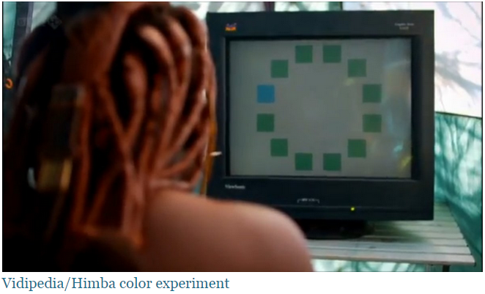
What is Classification?
Which of these squares is a different shade?
Courtesy: http://www.businessinsider.in/No-one-could-see-the-color-blue-until-modern-times/articleshow/46403449.cms

Slide 11
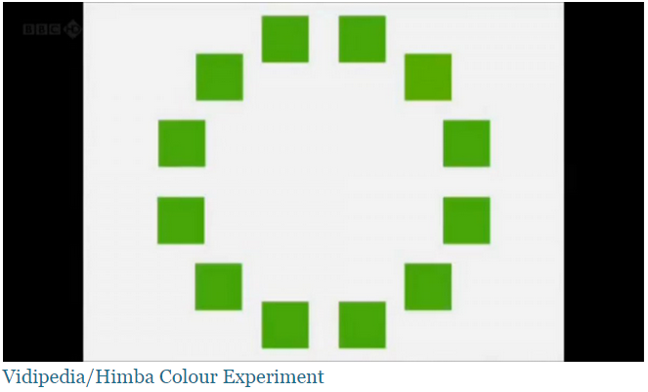
What is Classification?
Which of these squares is a different shade?

Slide 12
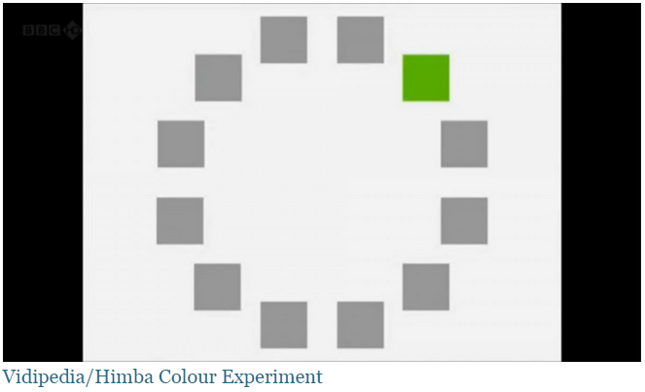
What is Classification?
Which of these squares is a different shade?

Slide 13
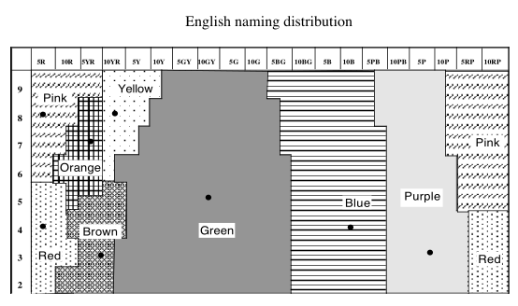
What is Classification?
Training data in the English language.

Slide 14
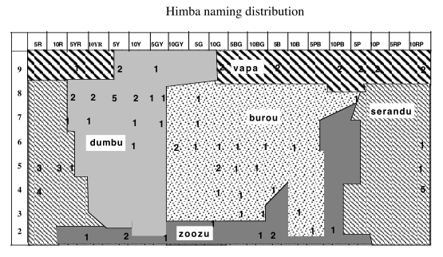
What is Classification?
Training data in the Himba language.

Slide 15
That ML Tool is the Classifier
What is a Classifier?
Something that performs classification.
Classification = categorizing
Classification = deciding
Classification = labelling
Classification = Deciding = Labelling

Slide 16
Classification = Deciding = Labelling
5’ 8”
6’2”
5’11”
5’11”
5’8”
6’6”
5’ 2”
6’9”
6’8”
6’10”
Classify these door heights as: Short or Tall ?

Slide 17
Classification = Deciding = Labelling
5’ 8” Short
6’2” Tall
5’11” Short
5’11”
5’8”
6’6” Tall
5’ 2” Short
6’9”
6’8”
6’10” Tall
For classification, you always start with
some labelled data points.

Slide 18
Classification = Deciding = Labelling
5’ 8” Short
6’2” Tall
5’11” Short
5’11” Short
5’8” Short
6’6” Tall
5’ 2” Short
6’9” Tall
6’8” Tall
6’10” Tall
If you were doing analysis, you’d ask a human to come up with a rule like:
A door below 6’ is Short else it’s Tall

Slide 19
Classification = Deciding = Labelling
5’ 8” Short
6’2” Tall
5’11” Short
5’11”
5’8”
6’6” Tall
5’ 2” Short
6’9”
6’8”
6’10” Tall
In ML, you just provide some examples.
The computer discovers the rule.

Slide 20
Classification = Deciding = Labelling
5’ 8” Short
6’2” Tall
5’11” Short
5’11”
5’8”
6’6” Tall
5’ 2” Short
6’9”
6’8”
6’10” Tall
The ML algorithm learns something like:
A door below 6’ is Short else it’s Tall

Slide 21
Classification = Deciding = Labelling
5’ 8” Short
6’2” Tall
5’11” Short
5’11” Short
5’8” Short
6’6” Tall
5’ 2” Short
6’9” Tall
6’8” Tall
6’10” Tall
You will learn to create an ML algorithm that learns something like this and that works with text.

Slide 22
Topic Classification
The United Nations Security Council today
Manchester United beat Barca to reach
Can you tell which is about Politics and which is about Sports?

Slide 23
Topic Classification
Politics
Sports
The United Nations Security Council today
Manchester United beat Barca to reach
Can you train an ML algorithm to tell which is about Politics and which is about Sports?
Yes, but you need to learn some probability theory.

Slide 24
What is a probability?
Definitions
Outcome
Sample Space S
Event E
Axioms of Probability
Axiom 1: 0 <= P(E) <= 1
Axiom 2: P(S) = 1
Axiom 3: P(union [ E ]) = sum[ P(E) ]
for mutually exclusive events.
Just Remember
A number between 0 and 1
Adds up to 1

Slide 25
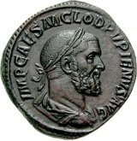
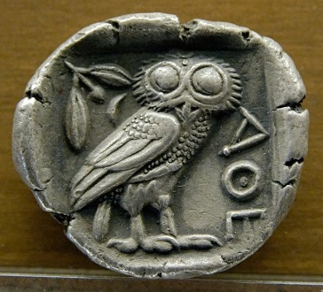
What is a probability?
A number between 0 and 1
The sum of the probabilities on all outcomes is 1
Heads Tails
P(heads) = 0.5
P(tails) = 0.5

Slide 26
Concept 1 - What is a joint probability?
Chance of something happening and something else happening.
Chance of something happening at the same time as something else.
Chance of seeing the word Barack and the word Obama in a document.
Chance of the document being about Sports and having the word ‘innings’ in it.

Slide 27
Concept 1 - What is a joint probability?
Definitions
Outcomes of multiple (say 2) experiments
Sample Spaces S1 and S2
Events E and F
Axioms of Probability
Axiom 1: 0 <= P(EF) <= 1
Axiom 2: P(S1 & S2) = 1
Axiom 3: P(union [ EF ]) = sum[ P(EF) ]
for mutually exclusive events.
Again just Remember
A number between 0 and 1
Adds up to 1 for all combinations of events E and F

Slide 28
Joint Probability Table
Combo | E | F | P(EF)
1 | T | T | 0.3
2 | T | H | 0.2
3 | H | T | 0.3
4 | H | H | 0.2
Total |  |  | 1.0
Note, these are not coin tosses. Assume these two coins have been tossed 10000 times.
Can you tell which coin is biased?

Slide 29
P(E)
Combo | E | F | P(E)
1 | T | T | 0.3 + 0.2 = 0.5
2 | T | H
3 | H | T | 0.3 + 0.2 = 0.5
4 | H | H
Total |  |  | 1.0

Slide 30
Reordered Joint Probability Table
Combo | E | F | P(EF)
1 | T | T | 0.3
3 | H | T | 0.3
2 | T | H | 0.2
4 | H | H | 0.2
Total |  |  | 1.0

Slide 31
P(F)
Combo | E | F | P(F)
1 | T | T | 0.3 + 0.3 = 0.6
3 | H | T
2 | T | H | 0.2 + 0.2 = 0.4
4 | H | H
Total |  |  | 1.0

Slide 32
Concept 2 - What is a conditional probability?
Chance of something happening when you know that something else has happened.
Chance of something happening given something else happens.
Chance of seeing the word Barack in a document when you see the word Obama.
Chance of the document being about Sports when you see the word ‘innings’ in it.

Slide 33
Concept 2 - What is a conditional probability?
Conditional Probability
If P(F) > 0, then P(E|F) = P(EF) / P(F)
Definitions
Outcome given another outcome
Sample Space S conditioned on the outcome of another experiment
Event E given another event F
Axioms of Probability
Axiom 1: 0 <= P(E|F) <= 1
Axiom 2: P(S) = sum over all E of P(E|F) = 1
Axiom 3: P(union [ E|F ]) = sum[ P(E|F) ]
for mutually exclusive events E.

Slide 34
Conditional Probability Table
Combo | E | F | P(EF) & P(F) | P(E|F) = P(EF)/P(F)
1 | T | T | 0.3 & 0.6 | 0.5
2 | T | H | 0.2 & 0.4 | 0.5
3 | H | T | 0.3 & 0.6 | 0.5
4 | H | H | 0.2 & 0.4 | 0.5
Total |  |  | 1.0 | 2.0 ??

Slide 35
Conditional Probability Table
Combo | E | F | P(E) | P(E|F) = P(EF)/P(F)
1 | T | T | 0.5 | 0.5
2 | T | H | 0.5 | 0.5
3 | H | T | 0.5 | 0.5
4 | H | H | 0.5 | 0.5
Is there a meaning to the pattern in the last two columns?

Slide 36
Topic Classification
Politics
Sports
The United Nations
Manchester United
The United States and
Manchester and Barca
Start by taking some samples of documents on politics and some samples of sports documents.
We’re using really short documents so you can do all the calculations manually & see that this ML algorithm really works!

Slide 37
Step 1: Learn Multinomial Probabilities
The United Nations
Politics
The United States and
Manchester United
Sports
Manchester and Barca
P(and/Politics) = 1/7
P(The/Politics) = 2/7
P(and/Sports) = 1/5
P(United/Politics) = 2/7
P(Manchester/Sports) = 2/5
P(Nations/Politics) = 1/7
P(United/Sports) = 1/5
P(States/Politics) = 1/7
P(Barca/Sports) = 1/5
P(Politics) = 7/12
P(Sports) = 5/12

Slide 38
One ML Algorithm
Step 1 was easy!!!
Are you ready for Step 2 ?

Slide 39
Step 2: There’s no step 2
This is a Naïve Bayesian Classifier!!!
P(and/Politics) = 1/7
P(The/Politics) = 2/7
P(and/Sports) = 1/5
P(United/Politics) = 2/7
P(Manchester/Sports) = 2/5
P(Nations/Politics) = 1/7
P(United/Sports) = 1/5
P(States/Politics) = 1/7
P(Barca/Sports) = 1/5
P(Politics) = 7/12
P(Sports) = 5/12

Slide 40
One ML Algorithm
Let’s put the classifier to work:
Let’s see if it can classify the following documents :
United Nations
Manchester United
We are using deliberately short documents!

Slide 41
Running the Topic Classifier
United Nations
P(Sports|United Nations)
= P(United|S)*P(Nations|Sports)*P(Sports)
= (1/5)*(0)*(5/12) = 0
P(Politics|United Nations)
= P(United|P)*P(Nations|Politics)*P(Politics)
= (2/7)*(1/7)*(7/12) = 1/(7*6)

Slide 42
Running the Topic Classifier
United Nations
P(Politics|United Nations)
>
P(Sports|United Nations)
So, the classifier has returned the category POLITICS

Slide 43
Running the Topic Classifier
Manchester United
P(Sports|Manchester United)
= P(Manchester|S)*P(United|S)*P(Sports)
= (2/5)*(1/5)*(5/12) = 2/(5*12)
P(Politics|Manchester United)
= P(Manchester|P)*P(United|P)*P(Politics)
= (0)*(2/7)*(7/12) = 0

Slide 44
Running the Topic Classifier
Manchester United
P(Sports|Manchester United)
>
P(Politics|Manchester United)
So, the classifier has returned the category SPORTS

Slide 45
Oh more on those zeros
In the slides on running the Naïve Bayesian classifier, the zero probabilities were in red because in a real classifier we would:
Replace zero probabilities by a small non-zero value (this is called smoothing – read the Chen and Goodman paper for details)
Instead of multiplying probabilities (which would lead to floating point underflow) we would add log probabilities.

Slide 46
Topic Classification
Politics
Sports
United Nations
Manchester United
We have successfully used an ML algorithm to tell us which document is about Politics and which is about Sports !!!

Slide 47
Can We Solve Other Problems?
Now, we have an ML tool in our toolkit – a Naïve Bayesian classifier.

Slide 48
Can We Solve Other Problems?
Now, we have an ML tool in our toolkit – a Naïve Bayesian classifier.
So, if we can represent a text analysis problem
as a classification task, then we can solve it
using ML.

Slide 49
Can We Solve Other Problems?
Now, we have an ML tool in our toolkit – a Naïve Bayesian classifier.
So, if we can represent a text analysis problem
as a classification task, then we can solve it
using ML.
So, let us learn how to represent text analysis
problems as classification tasks.

Slide 50
Problem 1: Sentence Segmentation
The problem of identifying the end-points of sentences is called sentence segmentation. It can be reduced to a classification problem.

Slide 51
Sentence Segmentation
Yes, Mr. Anurag. You need a D.L. to drive.
Sentence segmentation
Classify each ‘.’, ‘!’ and ‘?’ into:
sentence terminator and
not a sentence terminator.

Slide 52
Sentence Segmentation
Hurray! We have turned the problem of sentence segmentation into a classification problem.
Once you have modeled a text analytics problem as an ML problem, there is one more step you need to perform to get a working solution.

Slide 53
Sentence Segmentation
FIND THE FEATURES!

Slide 54
Features
Which country’s flag is this?
Features are the clues you need for good decision making.

Slide 55
Features
Which country’s flag is this?
One important feature for solving this decision problem is colour.

Slide 56
Features for Topic Classification
For topic classification, the features are the individual words in the text.
P(and/Politics) = 1/7
P(The/Politics) = 2/7
P(and/Sports) = 1/5
P(United/Politics) = 2/7
P(Manchester/Sports) = 2/5
P(Nations/Politics) = 1/7
P(United/Sports) = 1/5
P(States/Politics) = 1/7
P(Barca/Sports) = 1/5
P(Politics) = 7/12
P(Sports) = 5/12

Slide 57
Sentence Segmentation
Yes, Mr. Anurag. You need a D.L. to drive.
What are the features you would use?
That’s when you start reading the research papers!!!

Slide 58
Sentence Segmentation
Yes, Mr. Anurag. You need a D.L. to drive.
What are the features you would use?
Is_This_Character_a_Dot
Is_This_Within_Quotes
Is_Next_Letter_Capitalized
Is_Prev_Letter_Capitalized
Number_of_Words_in_Sentence_so_Far
Is_Next_Word_a_Name

Slide 59
Sentence Segmentation
Train an NB classifier on some text whose characters are marked as sentence terminators or not.
It will learn to assign characters to the categories sentence terminator and not a sentence terminator.

Slide 60
Problem 2: Tokenization
Now, get a D.L., Mr. Anurag.
Now , get a D.L. , Mr. Anurag .
For almost all analyses, you have to identify the individual words in the text.
How can you break a sentence into words?

Slide 61
Tokenization
Yes, Mr. Anurag. You need a D.L. to drive.
Tokenization
Classify each ‘.’, ‘!’, ‘,’, ‘ ’, ‘?’ etc. into:
word terminator and
not a word terminator.

Slide 62
Tokenization
We have turned the problem of word segmentation into a classification problem.
Train a classifier on text whose characters are marked as word terminators or not. It will learn to assign characters to the categories word terminator and not a word terminator.

Slide 63
Tokenization
Yes, Mr. Anurag. You need a D.L. to drive.
What are the features you would use?
Again, start reading the research papers.

Slide 64
Tokenization
Yes, Mr. Anurag. You need a D.L. to drive.
What are the features you would use?
Is_This_Character_a_Dot
Is_This_Within_Quotes
Is_Next_Letter_Capitalized
Is_Prev_Letter_Capitalized
Number_of_Words_in_Sentence_so_Far
Is_Next_Word_a_Name

Slide 65
Problem 2 an another guise: Word Segmentation
私の名前は山本です。
My name is Yamamoto.
私 の 名前 は 山本 です 。
In two of the CJK languages, the words in the text are written together without spaces.
How can you break a sentence into words?

Slide 66
Let’s try tokenizing some Japanese text
私の名前は山本です。
My name is Yamamoto.
私 の 名前 は 山本 です 。
Can Word Segmentation be cast as a classification problem?

Slide 67
Word Segmentation As Classification
Take every boundary between two characters
私|の|名|前|は|山|本|で|す|。
Classify the boundary into “word separator” and “not word separator”.
私|の|名|前|は|山|本|で|す|。
Replace “word separators” with spaces:
私 の 名前 は 山本 です 。

Slide 68
Word Segmentation
私|の|名|前|は|山|本|で|す|。
What are the features you would use?

Slide 69
Word Segmentation
私|の|名|前|は|山|本|で|す|。
You usually need a dictionary of words in the language.
A very important boolean feature is, can I see the letters after the last word boundary in the dictionary.

Slide 70
Time for Exercises!
Let’s do some exercises on feature engineering!
Gender classification
Language classification
Topic classification

Slide 71
Problem 3: Identifying Stop Words
Stop words: In computing, stop words are words which are filtered out before or after processing of natural language data (text). (wikipedia)
Stop words are words which do not contain much semantic information. They mostly serve syntactic functions.
Generally, the grammatical category of words called function words (or the closed category) are considered stop words.

Slide 72
Some Linguistics
Word categories:
Noun
Verb
Adjective
Adverb
Interjection
Conjunction (and, or, if, neither … nor)
Pronoun (I, it, you, them)
Preposition (in, of, out)

Slide 73
Some Linguistics
Word categories:
Noun
Verb
Adjective
Adverb
Interjection
Conjunction (and, or, if, neither … nor)
Pronoun (I, it, you, them)
Preposition (in, of, out)
Open Category or
Content Words

Slide 74
Some Linguistics
Word categories:
Noun
Verb
Adjective
Adverb
Interjection
Conjunction (and, or, if, neither … nor)
Pronoun (I, it, you, them)
Preposition (in, of, out)
Closed Category or
Function Words

Slide 75
Identify the function words in the following text:
Function words are words that have little lexical meaning or have ambiguous meaning, but instead serve to express grammatical relationships with other words within a sentence, or specify the attitude or mood of the speaker.
Conjunction (and, or, if, neither … nor)
Pronoun (I, it, you, them)
Preposition (in, of, out)
Function Words

Slide 76
Identify the function words in the following text:
Function words are words that have little lexical meaning or have ambiguous meaning, but instead serve to express grammatical relationships with other words within a sentence, or specify the attitude or mood of the speaker.
Conjunction (and, or, if, neither … nor)
Pronoun (I, it, you, them)
Preposition (in, of, out)
Function Words

Slide 77
If I am looking at text in an unknown language, how can I identify function words?
Function words are words that have little lexical meaning or have ambiguous meaning, but instead serve to express grammatical relationships with other words within a sentence, or specify the attitude or mood of the speaker.
Conjunction (and, or, if, neither … nor)
Pronoun (I, it, you, them)
Preposition (in, of, out)
Function Words

Slide 78
If I am looking at text in an unknown language, how can I identify function words?
Function words are words that have little lexical meaning or have ambiguous meaning, but instead serve to express grammatical relationships with other words within a sentence, or specify the attitude or mood of the speaker.
Is this a good rule:
“Any word after a comma is a function word”?

Slide 79
If I am looking at text in an unknown language, how can I identify function words?
Function words are words that have little lexical meaning or have ambiguous meaning, but instead serve to express grammatical relationships with other words within a sentence, or specify the attitude or mood of the speaker.
“Any word after a comma is a function word”?
‘It was a cold, cold day in December.’

Slide 80
The most frequent words …
Courtesy http://www.wordcount.org/main.php
The, of, and, to, a, in, that, it, is, was, i, for, on, you, he, be, with, as, by, at, have, are, this, not, but, had, his, they, from, she, which, or, we, an, there, her, were, one, do, been, all, their, has, would, will, what, if, can, when, so, no, said, who, more, about, up, them, some, could, him, into, its, then, two, out, ...
Conjunction (and, or, if, neither … nor)
Pronoun (I, it, you, them)
Preposition (in, of, out)
Function Words

Slide 81
Statistical Approach
Counting (frequencies / statistics) can tell you things that rules cannot …
So, we use probabilities and statistics to aid in decision making about text … instead of rules like “I before E except after C”

Slide 82
Statistical Approach
The most frequent words approach is derived from Zipf’s Law:
The Principle of Least Effort
“People will act so as to minimize their probably average rate of work”
The frequency of a word is inversely proportional to the length of the word

Slide 83
Problem 3 continued: Part of Speech (POS) Tagging
Anurag needs a D.L.
Anurag/NNP needs/VBZ a/DT D.L./NN
How do you tag the words in a sentence?

Slide 84
Problem 3: Part of Speech (POS) Tagging
You turn the problem of POS Tagging into a classification problem where you label each word as:
Noun
Verb
Adjective
Adverb
Interjection
Conjunction (and, or, if, neither … nor)
Pronoun (I, it, you, them)
Preposition (in, of, out)

Slide 85
Problem 3: Part of Speech (POS) Tagging
Anurag needs a D.L.
Anurag/NNP needs/VBZ a/DT D.L./NN
POS Tagging
Run from the first to the last word in the sentence, classifying each word in the sentence into a part-of-speech category.

Slide 86
Problem 3: Part of Speech (POS) Tagging
I will run/VBZ
I was in the run/NN
POS Tagging as sequential classification
Why did the POS tagger decide differently about the word ‘run’ in these two cases?

Slide 87
Problem 3: Part of Speech (POS) Tagging
I/PRP will/MD run/VB
I/PRP was/VBD in/IN the/DT run/NN
POS Tagging as sequential classification
Why did the POS tagger decide differently about the word ‘run’ in these two cases?
Answer: The previous decision!!!

Slide 88
Sequential Classification
What is a Sequential Classifier?
Something that performs classification on an ordered collection, such that each decision depends on previous decision(s).
Classification = categorizing
Classification = deciding
Classification = labelling
Classifying = Labelling = Deciding

Slide 89
Sequential Classification
We have our first design pattern:
Sequential classification
When do you use it?
Sequence of decisions where every decision depends on an earlier decision.

Slide 90
Problem 4: Sentiment Classification
John loves to use Canon cameras.
?

Slide 91
Problem 4: Sentiment Classification
John loves to use Canon cameras.
positive
Sentiment Classification
Sentence-Level Sentiment: Classify the whole sentence into positive, negative, neutral

Slide 92
Sentiment Classification
Café XYZ has a splendid selection of cakes.
Is this positive or negative?
What word clues you in to the polarity?

Slide 93
Words
Adjectives Hatzivassiloglou & McKeown 1997, Wiebe 2000, Kamps & Marx 2002, Andreevskaia & Bergler 2006
positive: honest important mature large patient
Ron Paul is the only honest man in Washington.
Kitchell’s writing is unbelievably mature and is only likely to get better.
To humour me my patient father agrees yet again to my choice of film
From Slides of Carmen Banea

Slide 94
Words
Adjectives
negative: harmful hypocritical inefficient insecure
It was a macabre and hypocritical circus.
Why are they being so inefficient ?peculiar, odd, likely, probably
From Slides of Carmen Banea

Slide 95
Sentiment Classification
I like XYZ café very much.
Is this positive or negative?
What word clues you in to the polarity?

Slide 96
Words
Other parts of speech Turney & Littman 2003, Riloff, Wiebe & Wilson 2003, Esuli & Sebastiani 2006
Verbs
positive: praise, love
negative: blame, criticize
From Slides of Carmen Banea

Slide 97
Sentiment Classification
It was a pleasure to have a cake at café XYZ.
Is this positive or negative?
What word clues you in to the polarity?

Slide 98
Words
Other parts of speech Turney & Littman 2003, Riloff, Wiebe & Wilson 2003, Esuli & Sebastiani 2006
Nouns
positive: pleasure, enjoyment
negative: pain, criticism
From Slides of Carmen Banea

Slide 99
Sentiment Classification
B. Pang, L. Lee, and S. Vaithyanathan, “Thumbs up? Sentiment classification using machine learning techniques,” in Proceedings of the Conference on Empirical Methods in Natural Language Processing (EMNLP) 2002

Slide 100
Challenge: Sentiment Classification
Is this enough in the real world?
Can you use the above classifier in real life?

Slide 101
Challenge: Subjectivity Classification
John loves to use Canon cameras.
subjective
Subjectivity Classification
Sentence-Level Sentiment: Classify the whole sentence into subjective, objective

Slide 102
Subjectivity Detection
I am only trying to protect my good name
Is this positive or negative?
Is this subjective or objective?

Slide 103
Subjectivity Detection
B. Pang and L. Lee, “A sentimental education: Sentiment analysis using subjectivity summarization based on minimum cuts,” in Proceedings of the Association for Computational Linguistics (ACL), pp. 271–278, 2004.

Slide 104
Subjectivity Detection / Sentiment Classification
Sentiment Analysis | Subjectivity analysis
Positive | Subjective
Negative
Neutral | Objective
From Slides of Carmen Banea

Slide 105
Time for Exercises!
Let’s practise!
POS tagging
Sentiment classification
Subjectivity classification

Slide 106
Finer Granularity
We looked at
Document level sentiment classification.
Sentence level sentiment classification.
Can we get more granular than that?

Slide 107
Feature Level Sentiment Analysis
M. Hu and B. Liu, “Mining opinion features in customer reviews,” in Proceedings of AAAI, pp. 755–760, 2004.
A.-M. Popescu and O. Etzioni, “Extracting product features and opinions from reviews,” in Proceedings of the Human Language Technology Conference and the Conference on Empirical Methods in Natural Language Processing (HLT/EMNLP), 2005.

Slide 108
Feature Level Sentiment Analysis
I like the red Toyota in the parking lot but think the green one is rather ugly.
+ red Toyota
- green one

Slide 109
Phrase Level Sentiment Analysis Step 1
John loves to use Canon cameras.
John = Holder
Loves = Sentiment
Canon cameras = Object
Step 1:
Sentiment Analysis
Phrase-Level Sentiment: Extract entities holder, object, sentiment

Slide 110
Phrase Level Sentiment Analysis Step 2
John loves to use Canon cameras.
{John = Holder, Loves = Sentiment, Canon cameras = Object} => positive sentiment relation
Step 2:
Sentiment Analysis
Phrase-Level Sentiment: Extract relations between {holder, object, sentiment}

Slide 111
Sentiment Analysis
Good overview in 2009 OMSA article: “Opinion Mining and Sentiment Analysis” by Pang and Lee

Slide 112
Problem 5: Named Entity Recognition
Anurag is looking for a Hyundai car in Bangalore
Anurag = Person
Hyundai car = Vehicle
Bangalore = Place
How do you extract the named entities in a sentence using a classifier?

Slide 113
Problem 5: Named Entity Recognition
Anurag is looking for a Hyundai car in Bangalore
Anurag = Person
Hyundai car = Vehicle
Bangalore = Place
Anurag/Person is/Other looking/Other for/Other a/Other Hyundai/Vehicle car/Vehicle in/Other Bangalore/Place

Slide 114
Problem 5: Named Entity Recognition
We have turned the problem of Named Entity Recognition (NER) into a Tagging problem where you label each word as:
Person
Vehicle
Place

Slide 115
Problem 5: Named Entity Recognition
But we know that we can turn the problem of Tagging into a Classification problem over the same labels:
Person
Vehicle
Place

Slide 116
Problem 5: Named Entity Recognition
Anurag is looking for a Hyundai car in Bangalore
Anurag/Person is/Other looking/Other for/Other a/Other Hyundai/Vehicle car/Vehicle in/Other Bangalore/Place
Named Entity Recognition
Run from the first to the last word in the sentence, classifying each word in the sentence into a Named Entity Recognition category.

Slide 117
Hey We Have One More ML Tool
We just built one more very useful ML tool!
The Extractor ☺

Slide 118
Extraction
What is an Extractor?
Something that performs extraction.
Extraction = recognizing
Extraction = finding
Extraction = locating
Extraction = Finding = Locating

Slide 119
Extraction
We have our second design pattern:
Extraction
When do you use it?
When the number of choices is infinite.

Slide 120
Problem 6: Relation Extraction
Tim Cook is the new CEO of Apple Computers
Relation: CEO_of
Tim Cook (Person) Apple Computers (Org)
How do you identify relations between entities in a sentence using a classifier?

Slide 121
Extracting Meaning
Relation Extraction
Text: Tim Cook is the new CEO of Apple Computers
Step 1:
Analysis: Tim/Person Cook/Person is the new CEO
of Apple/Org Computers/Org

Slide 122
Extracting Meaning
Relation Extraction
Text: Tim Cook is the new CEO of Apple Computers
Step 1:
Analysis: Tim/Person Cook/Person is the new CEO
of Apple/Org Computers/Org
Step 2:
Relation Extraction
{Tim/Person Cook/Person, Apple/Org Computers/Org} => CEO_of

Slide 123
Extracting Meaning
Relation Extraction
Text: Tim Cook is the new CEO of Apple Computers
Step 1:
Analysis: Tim/Person Cook/Person is the new CEO
of Apple/Org Computers/Org
Step 2:
Relation Extraction
Run through all pairs of named entities, classifying each pair into CEO_of or Other.

Slide 124
But look at what we’re extracting!
Do you realize what we’re extracting?
Meaning !!! ☺

Slide 125
Extracting Meaning
Semantic Analysis: I/Person am looking for a
Hyundai/Vehicle car/Vehicle in Bangalore/Place
Syntactic Analysis: I/Pronoun am/BE looking/V for a/DT Hyundai/NP car/NN in/PP Bangalore/NP
Text: I am looking for a Hyundai car in B’lore

Slide 126
But is this comprehensive?
Are you telling me that this is all I have to do to extract every possible sort of simple meaning?
Yeah!!! ☺
All utterances fall into two main categories …

Slide 127
360 Degree Text Analysis
Two Kinds of Utterances
Intentional: I want to buy a computer.
Information: There was heavy snowfall in Sikkim.

Slide 128
360 Degree Text Analysis
How do you deal with intentional utterances
I want to buy a computer.

Slide 129
Intentional Utterance
Intention Analysis
Raw Text: Are you sad that Steve Jobs died?
Analysis: This person is inquiring about
someone’s emotions concerning Steve Jobs
Intention Holder: I
Intention: inquire

Slide 130
Subjective Utterance
Sentiment Analysis
Raw Text: I am sad that Steve Jobs died
Analysis: This person holds a positive opinion
on Steve Jobs
Sentiment Holder: I
Object of Sentiment: Steve Jobs
Polarity of Sentiment: positive

Slide 131
360 Degree Text Analysis
How do you deal with informational utterances
There was heavy snowfall in Sikkim.

Slide 132
Approaches to Extracting Meaning
Event Analysis
Raw Text: There is heavy snowfall in Sikkim.
Analysis: Snowfall event
Event: snowfall

Slide 133
Approaches to Extracting Meaning
Fact Analysis
Raw Text: Bangalore is the capital of K’taka
Analysis: capital_of relation exists
Entity: Bangalore/Place
Karnataka/Place
Relation: Bangalore capital_of K’taka

Slide 134
Fact Analysis
Extracting Meaning
Entity Extraction
Text: I am looking for a Hyundai car in Bangalore
Semantic Analysis: I/Person am looking for a
Hyundai/Thing car/Thing in Bangalore/Place
Entities:
I Person
Hyundai car Thing
Bangalore Place

Slide 135
Fact Analysis
Extracting Meaning
Relation Extraction
Text: Tim Cook is the new CEO of Apple Computers
Analysis: Tim/Person Cook/Person is the new CEO
of Apple/Org Computers/Org
Relation: CEO_of
Tim Cook (Person) Apple Computers(Org)

Slide 136
Converting Unstructured to Structured Data
Read the whitepaper:
http://aiaioo.com/whitepapers/text_analytics_360.pdf

Slide 137
Problem 6 again: Question Answering
Who is the CEO of Apple Computers?
Relation: CEO_of
? (Person) Apple Computers (Org)
How do you answer a factoid question?

Slide 138
Problem 6 again: Question Answering
Who is the CEO of Apple Computers?
Relation: CEO_of
? (Person) Apple Computers (Org)
Factoid question answering can be modeled using relation extraction.

Slide 139
Problem 6 again: Question Answering
Who is the CEO of Apple Computers?
Relation: CEO_of
? (Person) Apple Computers (Org)
A factoid question specifies a relation and one of the entities.

Slide 140
Problem 6 again: Question Answering
Fetch this document using IR:
Tim Cook is the new CEO of Apple Computers
You’ve already developed a way to mark it as:
Relation: CEO_of
Tim Cook (Person) Apple Computers (Org)
Since you have the relation and the query entity, you just have to return the requested entity

Slide 141
So, I can do anything (badly?)
I got it! I got it! I can do anything.
But how do I know how well I am doing it ? 😐

Slide 142
Measurement
Measurement:
This measurement thing is very important in any design process, because …

Slide 143
Measurement
Measurement:
… it lets you compare two designs and decide which is better.
How do you measure the performance of a classifier?

Slide 144
Before we go on …
… promise me …
… that you will never forget what I am about to tell you … ☹

Slide 145
Measurement
Break up the data points into training and test parts (usually an 80:20 split) and never test on your training data.

Slide 146
Measurement
Break up the data points into training and test – usually an 80:20 split.
Train on 80%
Test on the remaining 20%
Why not test on the training data?

Slide 147
Measurement
Or if you are still developing features,
break up the data points into training, development and test – usually a 70:10:20 split.
Train on 70%
Develop on 10%
Test on the remaining 20%
Why not develop on the test data?

Slide 148
That applies to college as well …
… you won’t get accurate measurements …
… if you test students using questions that appeared in the question bank!
… and you will be encouraging students to learn things by rote!

Slide 149
Classification Quality Metric - Accuracy
Correct Answers
Total Number of Questions

Slide 150
Classification Quality Metric - Accuracy
If your categories are Politics and Sports
Politics Documents classified as Politics
+ Sports Documents classified as Sports
Total Number of Documents

Slide 151
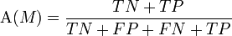
Classification Quality Metric - Accuracy
Point of View = Sports = (+ve)
 | Gold - Politics | Gold – Sports
Observed - Politics | TN (True Negative) | FN (False Positive)
Observed - Sports | FP (False Negative) | TP (True Positive)

Slide 152
Accuracy
Point of View - Politics
 | Gold – Sports (1000) | Gold – Politics (1000)
Observed – Sports | TN = 990 | FN = 100
Observed – Politics | FP = 10 | TP = 900
= ?

Slide 153
Accuracy
Point of View - Politics
 | Gold – Sports (1000) | Gold – Politics (1000)
Observed – Sports | TN = 990 | FN = 100
Observed – Politics | FP = 10 | TP = 900
= 94.5%

Slide 154
Classification Quality Metric - Recall
How many Politics document did it find
Total number of Politics documents in the test data

Slide 155
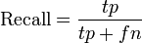
Recall
Point of View - Politics
 | Gold – Sports (1000) | Gold – Politics (1000)
Observed – Sports | TN = 990 | FN = 100
Observed – Politics | FP = 10 | TP = 900
= ?

Slide 156
Recall
Point of View - Politics
 | Gold – Sports (1000) | Gold – Politics (1000)
Observed – Sports | TN = 990 | FN = 100
Observed – Politics | FP = 10 | TP = 900
= 90%

Slide 157
Recall
Point of View - Sports
 | Gold – Sports (1000) | Gold – Politics (1000)
Observed – Sports | TP = 990 | FP = 100
Observed – Politics | FN = 10 | TN = 900
= ?

Slide 158
Recall
Point of View - Sports
 | Gold – Sports (1000) | Gold – Politics (1000)
Observed – Sports | TP = 990 | FP = 100
Observed – Politics | FN = 10 | TN = 900
= 99%

Slide 159
Classification Quality Metric - Precision
How many were really Politics documents
Total number of documents the classifier identified as Politics

Slide 160
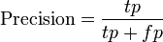
Precision
Point of View - Politics
 | Gold – Sports (1040) | Gold – Politics (960)
Observed – Sports | TN = 990 | FN = 10
Observed – Politics | FP = 50 | TP = 950
= ?

Slide 161
Precision
Point of View - Politics
 | Gold – Sports (1040) | Gold – Politics (960)
Observed – Sports | TN = 990 | FN = 10
Observed – Politics | FP = 50 | TP = 950
= 95%

Slide 162
Precision
Point of View - Sports
 | Gold – Sports (1040) | Gold – Politics (960)
Observed – Sports | TP = 990 | FP = 10
Observed – Politics | FN = 50 | TN = 950
= ?

Slide 163
Precision
Point of View - Sports
 | Gold – Sports (1040) | Gold – Politics (960)
Observed – Sports | TP = 990 | FP = 10
Observed – Politics | FN = 50 | TN = 950
= 99%

Slide 164
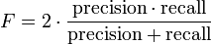
Metrics for Measuring Classification Quality
F-Score = the harmonic mean of Precision and Recall

Slide 165
F-Score Generalized

Slide 166
F-Score Generalized
1

Slide 167
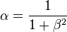
F-Score Generalized

Slide 168
Precision and Recall Tradeoff?
 | Gold Class 1 | Gold Class 2
Observed Class 1 | TP | FP
Observed Class 2 | FN | TN
Trade-off

Slide 169
Precision, Recall, Average, F-Score
 | Precision | Recall | Average | F-Score
Classifier 1 | 50% | 50% | 50% | ?
Classifier 2 | 30% | 70% | 50% | ?
Classifier 3 | 10% | 90% | 50% | ?
What is the sort of classifier that fares worst?

Slide 170
Precision, Recall, Average, F-Score
 | Precision | Recall | Average | F-Score
Classifier 1 | 50% | 50% | 50% | 50%
Classifier 2 | 30% | 70% | 50% | 42%
Classifier 3 | 10% | 90% | 50% | 18%
What is the sort of classifier that fares worst?

Slide 171
Measurement Exercise
Data Point | Real | Observed
D1 | Politics | Sports
D2 | Politics | Politics
D3 | Politics | Politics
D4 | Sports | Politics
D5 | Sports | Sports
D6 | Sports | Sports
D7 | Sports | Politics
D8 | Sports | Sports
What is the accuracy?

Slide 172
Measurement Exercise
Data Point | Real | Observed
D1 | Politics | Sports
D2 | Politics | Politics
D3 | Politics | Politics
D4 | Sports | Politics
D5 | Sports | Sports
D6 | Sports | Sports
D7 | Sports | Politics
D8 | Sports | Sports
What is the precision for Sports?

Slide 173
Measurement Exercise
Data Point | Real | Observed
D1 | Politics | Sports
D2 | Politics | Politics
D3 | Politics | Politics
D4 | Sports | Politics
D5 | Sports | Sports
D6 | Sports | Sports
D7 | Sports | Politics
D8 | Sports | Sports
What is the recall for Sports?

Slide 174
Measurement Exercise
Data Point | Real | Observed
D1 | Politics | Sports
D2 | Politics | Politics
D3 | Politics | Politics
D4 | Sports | Politics
D5 | Sports | Sports
D6 | Sports | Sports
D7 | Sports | Politics
D8 | Sports | Sports
What is the F-score for Sports?

Slide 175
Time for Exercises!
Let’s practise measurement!
Precision
Recall
F-Score
Confusion Matrices

Slide 176
Comparing Classifiers
Classification does not have to be about ML.
You can make decisions (classify) using rules.
There are also many kinds of ML.
Now, we have a way to compare them.

Slide 177
Let’s Look at these Types of Classifiers
Rule-based classifiers
Word Lists (Gazetteers)
Artificial Neural Networks (Perceptrons)
Naïve Bayesian Classifier
Maximum Entropy Classifiers
Support Vector Machines

Slide 178
Rule Based Classification

Slide 179
Decision Tree Classifier
Body Temperature
Cold
Warm
Non Mammal
Gives Birth
No
Yes
Non Mammal
Mammal
Examples from “Introduction to Data Mining” by Tan, Steinbach and Kumar

Slide 180
Decision Tree Classifier
Classifying a Data Point
Data Point | Flamingo
Body Temperature | Warm
Gives Birth | No
Class | ?
Body Temperature
Cold
Warm
Non Mammal
Gives Birth
No
Yes
Non Mammal
Mammal

Slide 181
Decision Tree Classifier
Classifying a Data Point
Data Point | Dog
Body Temperature | Warm
Gives Birth | Yes
Class | ?
Body Temperature
Cold
Warm
Non Mammal
Gives Birth
No
Yes
Non Mammal
Mammal

Slide 182
Decision Tree Classifier
Learning to Classify from Examples
ID | Home Owner | Marital Status | Annual Income | Defaulted Borrower
1 | Yes | Single | 125K | No
2 | No | Married | 100K | No
3 | No | Single | 70K | No
4 | Yes | Married | 120K | No
5 | No | Divorced | 95K | Yes
6 | No | Married | 60K | No
7 | Yes | Divorced | 220K | No
8 | No | Single | 85K | Yes
9 | No | Married | 75K | No
10 | No | Single | 90K | Yes

Slide 183
Decision Tree Classifier
Learning to Classify from Examples
Hunt’s Algorithm
Defaulted = No

Slide 184
Decision Tree Classifier
Learning to Classify from Examples
Now pick a splitting feature, let’s say “Home Owner”
Home Owner

Slide 185
Decision Tree Classifier
Learning to Classify from Examples
Hunt’s Algorithm
Home Owner
Yes
No
Defaulted = No
Defaulted = No

Slide 186
Decision Tree Classifier
Learning to Classify from Examples
Hunt’s Algorithm
Home Owner
Yes
No
Defaulted = No
Marital Status
No
Single, Divorced
Married
Defaulted = Yes
Defaulted = No

Slide 187
Decision Tree Classifier
Learning to Classify from Examples
Hunt’s Algorithm
Home Owner
Yes
No
Defaulted = No
Marital Status
No
Single, Divorced
Married
Income >= 80K
Defaulted = No
No
No
Yes
Defaulted = No
Defaulted = Yes

Slide 188
How Do You Choose The Next Splitting Feature
Impurity Metrics
Entropy
Gini Coefficient
Classification Error

Slide 189
How Do You Choose The Next Splitting Feature
Impurity Metrics
Entropy(t) = - sum over all classes of [p(i|t) log p(i|t)]
Gini(t) = 1 - sum over all classes of [p(i|t) ^ 2]
Classification Error(t) = 1 – max over all classes of [p(i|t)]

Slide 190
Impurity Metric Example
count(Class1) = 0, count(Class2) = 6
Entropy(t) = – 0/6 * log 0/6 – 6/6 * log 6/6
Gini(t) = 1 – (0/6)^2 – (6/6)^2
Classification Error(t) = 1 – max[0/6,6/6]

Slide 191
Impurity Metric Example
count(Class1) = 1, count(Class2) = 5
Entropy(t) = – 1/6 * log 1/6 – 5/6 * log 5/6 = 0.650
Gini(t) = 1 – (1/6)^2 – (5/6)^2 = 0.278
Classification Error(t) = 1 – max[1/6,5/6] = 0.167

Slide 192
Impurity Metric Example
count(Class1) = 3, count(Class2) = 3
Entropy(t) = – 3/6 * log 3/6 – 3/6 * log 3/6 = 1
Gini(t) = 1 – (3/6)^2 – (3/6)^2 = 0.5
Classification Error(t) = 1 – max[3/6,3/6] = 0.5

Slide 193
How Do You Choose The Next Splitting Feature
Use an Impurity Metric: Entropy, Gini or Classification Error
Pick the attribute that decreases the impurity metric the most

Slide 194
Example: Choosing Splitting Features
Features:
size: small medium large
colour: red blue green
shape: brick wedge sphere pillar
%% yes %% no
medium blue brick small red wedge
small red sphere large red wedge
large green pillar large red pillar
large green sphere
Reference: Bratko sections 18.5, 18.6

Slide 195
Example: Choosing Splitting Features
Initial decision tree is one node with all examples.
There are 4 positive examples and 3 negative examples
i.e. probability of positive is 4/7 = 0.57; probability of negative is 3/7 = 0.43
Entropy is: – (0.57 * log 0.57) – (0.43 * log 0.43) = 0.99
%% yes %% no
medium blue brick small red wedge
small red sphere large red wedge
large green pillar large red pillar
large green sphere
Reference: Bratko sections 18.5, 18.6

Slide 196
How Do You Choose The Next Splitting Feature
Suppose we split on size?
Try split on size which has three values:
large, medium and small.

Slide 197
Example: Choosing Splitting Features
There are four instances with size = large.
There are two large positive examples and two large negative examples.
The probability of positive is 0.5
The entropy is: – (0.5 * log 0.5) – (0.5 * log 0.5) = 1
%% yes %% no
medium blue brick small red wedge
small red sphere large red wedge
large green pillar large red pillar
large green sphere
Reference: Bratko sections 18.5, 18.6

Slide 198
Example: Choosing Splitting Features
There is 1 instance with size = medium.
There is 1 medium positive example and 0 medium negative examples.
The probability of positive is 1
The entropy is: – (1 * log 1) – (0 * log 0) = 0
%% yes %% no
medium blue brick small red wedge
small red sphere large red wedge
large green pillar large red pillar
large green sphere
Reference: Bratko sections 18.5, 18.6

Slide 199
Example: Choosing Splitting Features
There is 2 instances with size = small.
There is 1 medium positive example and 1 medium negative example.
The probability of positive is 0.5
The entropy is: – (0.5 * log 0.5) – (0.5 * log 0.5) = 1
%% yes %% no
medium blue brick small red wedge
small red sphere large red wedge
large green pillar large red pillar
large green sphere
Reference: Bratko sections 18.5, 18.6

Slide 200
Example: Choosing Splitting Features
Initial decision tree was one node with all examples.
There are 4 positive examples and 3 negative examples.
After splitting on size, we got 3 nodes with 4, 2 and 1 examples. So, the expected information is:
%% yes %% no
medium blue brick small red wedge
small red sphere large red wedge
large green pillar large red pillar
large green sphere
Reference: Bratko sections 18.5, 18.6

Slide 201
Example: Choosing Splitting Features
Initial decision tree was one node with entropy 0.99.
After splitting on size, we got 3 nodes with 4, 2 and 1 examples with expected information:
So, the information gain is: 0.99 – 0.86 = 0.13
%% yes %% no
medium blue brick small red wedge
small red sphere large red wedge
large green pillar large red pillar
large green sphere
Reference: Bratko sections 18.5, 18.6

Slide 202
How Do You Choose The Next Splitting Feature
Suppose we split on colour?
Try split on colour which has three values:
blue, red and green.
Colour has an information gain of 0.52
So, colour is a better parameter to split on than size.

Slide 203
How Do You Choose The Next Splitting Feature
Suppose we split on shape?
Try split on shape which has four values:
brick, wedge, sphere and pillar.
Shape has an information gain of 0.7
So, shape works better than colour or size.
Therefore split on shape.

Slide 204
Rule-Based Classifiers
Rules such as the following are mathematically equivalent to a Decision Tree
Example:
If sepal_length > 3 and sepal_width < 5 then class=setosa else class=versicolor
If the only features are sepal length and width (2 features), you can draw a line in 2D separating the two classes.

Slide 205
Rule-Based Classifiers
Sepal width < 5
Setosa
Sepal length > 3
Versicolor

Slide 206
Rule-Based Classifiers
Try a more complex rule to eliminate the blue point that is being classified as green.
Example:
If sepal_length > 3 and sepal_width < 5 OR sepal_length > 2 and sepal_width < 4 then class=setosa else class=versicolor
Now we get 2 more lines in 2D.

Slide 207
Rule-Based Classifiers

Slide 208
Rule-Based Classifiers
new

Slide 209
Rule-Based Classifiers
So, I’ll need an infinite number of rules!
Is there a machine learning algorithm that can handle this data?

Slide 210
Word-List Based Classification

Slide 211
Word List (Gazetteer)
A very simple classification technique that is used very often and works well if done correctly.

Slide 212
Classification for Text Categorization
Let’s say you want to classify these. Make a list of key words. What sort of words?
The United Nations Security Council will record its first clear condemnation of Syria for its continuing crackdown on protests, as the army continues its advance into Hama.
Warwickshire's Clarke equalled the first-class record of seven catches for an outfielder in an innings but Lancashire took control on day three.

Slide 213
Text Categorization using Lists of Words
These lists of words are also called gazetteers
Politics
Sports
United
Nations
Security
Record
Condemnation
Syria
Crackdown
Protests
Army
Hama
Manchester
United
Warwickshire
Clarke
First-class
Record
Catches
Outfielder
Innings
Lancashire

Slide 214
Word List (Gazetteer)
I can write rules like “If any work in the document matches a word in the word list for a category, it belongs to that category”.
This type of word list classification is a type of rule-based classifier.
Example:
If word1 exists in doc OR word2 exists in doc OR word3 exists in doc then class=C1 else class=C2

Slide 215
Word List (Gazetteer)
You can greatly improve the quality of this by counting.
I count occurrences of words from the word list for each category in the document.
If count(category1) > count(category2) in document, then category 1 else category2

Slide 216
Word List Topic Classification Example
United Nations
Manchester United

Slide 217
Word List Topic Classification Example
United Nations
Manchester United
count(Politics) = 2
count(Sports) = 1
count(Politics) = 1
count(Sports) = 2

Slide 218
Word List Topic Classification Example
Politics
Sports
United Nations
Manchester United
count(Politics) = 2
>
count(Sports) = 1
count(Politics) = 1
<
count(Sports) = 2
We have successfully used a rule-based algorithm to tell us which document is about Politics and which is about Sports !!!

Slide 219
Word List (Gazetteer)
A very simple classification technique that is used very often but never written about in textbooks.
I count occurrences of words from the word list for each category. If count(category1) > count(category2) in document, then category 1 else category2
Word lists are an improvement over decision tree classifiers because they involve counting.

Slide 220
Word List (a.k.a. Gazetteer)
The problem with words lists is, all the words (features) have equal weightage.
But hey, some words (features) might be better indicators of the topic than others.
So, what if we added a weight to the features … like what you see on the next slide …

Slide 221
Adding Weights to the Features
Let’s improve the gazetteer with weights
Politics
Sports
UN
Adopts
Condemnation
Syria
Crackdown
Protests
Army
Hama
1.0
0.1
0.2
0.3
0.8
1.0
0.8
1.0
Warwickshire
Clarke
First-class
Record
Catches
Outfielder
Innings
Lancashire
0.3
0.1
0.6
0.3
0.6
1.0
0.9
0.5

Slide 222
Weighted Gazetteers
But that’s exactly what machine learning models are – weighted gazetteers.

Slide 223
Weighted Gazetteers
But, counts multiplied by weights represent lines!
Eg: mx + ny is a 2 dimensional line
Eg: ax + by + cz is a 3 dimensional line
…

Slide 224
Weighted Gazetteers
But that’s exactly what machine learning models are – weighted gazetteers.
And the linear classifier had been invented!

Slide 225
Linear Classifiers
Artificial Neural Networks (Perceptrons)
Naïve Bayesian Classifier
Maximum Entropy Classifiers
Support Vector Machines

Slide 226
Perceptron

Slide 227
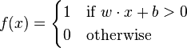
Perceptron
For binary (two class classification – 0 or 1)
f(x) returns the class 1 if w.x + b > 0.
f(x) returns the class 0 if w.x + b <= 0.
Courtesy Wikipedia

Slide 228
Perceptron Training
Steps
1. Initialize the weights and the threshold. Weights may be initialized to 0 or to a small random value.
Courtesy Wikipedia

Slide 229
Perceptron Training
Steps
2. For each example in the training set, perform the following steps:
Calculate the actual output:
Update the weights:
Courtesy Wikipedia

Slide 230
Perceptron Training
Steps
3. Repeat until the iteration error is less than a user-specified error threshold, or a predetermined number of iterations have been completed.
Courtesy Wikipedia

Slide 231
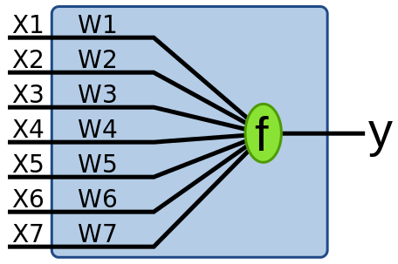
Now that you’ve learnt the weights
For binary (two class classification – 0 or 1)
Courtesy Wikipedia

Slide 232
Perceptron
Can separate two linearly separable data sets in hyperspace (a Euclidean space of dimension n).
Now we get 1 sloping line in 2D.

Slide 233
Perceptrons

Slide 234
The Problem with Perceptrons
Dependent on order of data
Jitter (the separating plane can move around a lot as you train it)
Sensitive to outliers appearing at the end of training

Slide 235
Perceptrons
new

Slide 236
The Jitter Problem with Perceptrons
Can we solve this problem using probabilities?

Slide 237
What if the Weights were Probabilities?
The gazetteer with weights
Politics
Sports
UN
Adopts
Condemnation
Syria
Crackdown
Protests
Army
Hama
1.0
0.1
0.2
0.3
0.8
1.0
0.8
1.0
Warwickshire
Clarke
First-class
Record
Catches
Outfielder
Innings
Lancashire
0.3
0.1
0.6
0.3
0.6
1.0
0.9
0.5

Slide 238
What if the Weights were Probabilities?
So … for these categories we’d have
Politics
Sports
UN
Adopts
Condemnation
Syria
Crackdown
Protests
Army
Hama
1.0
0.1
0.2
0.3
0.8
1.0
0.8
1.0
Warwickshire
Clarke
First-class
Record
Catches
Outfielder
Innings
Lancashire
0.3
0.1
0.6
0.3
0.6
1.0
0.9
0.5
P(Politics|Word) P(Sports|Word)

Slide 239
What is a probability?
A number between 0 and 1
The sum of the probabilities on all outcomes is 1
Heads Tails
P(heads) = 0.5
P(tails) = 0.5

Slide 240
Concept 1 - What is a joint probability?
Chance of something happening and something else happening.
Chance of something happening at the same time as something else.
Chance of seeing the word Barack and the word Obama in a document.
Chance of the document being about Sports and having the word ‘innings’ in it.

Slide 241
Concept 2 - What is a conditional probability?
Chance of something happening when you know that something else has happened.
Chance of something happening given something else happens.
Chance of seeing the word Barack in a document when you see the word Obama.
Chance of the document being about Sports when you see the word ‘innings’ in it.

Slide 242
Independence
Two events are independent
if the chance of one event
happening given the other is the same
as the chance of the event happening
irrespective of the other event.
To put it simply:
If P(E|F) = P(E)

Slide 243
Independence
Combo | E | F | P(E) | P(E|F) = P(EF)/P(F)
1 | T | T | 0.5 | 0.5
2 | T | H | 0.5 | 0.5
3 | H | T | 0.5 | 0.5
4 | H | H | 0.5 | 0.5
E and F are independent if P(E|F) = P(E)

Slide 244
The Independence Puzzle
Two events are independent
if the chance of one event
happening given the other is the same
as the chance of the event happening
irrespective of the other event.
If E and F are
Independent, show:
P(EF) = P(E)*P(F)

Slide 245
The Independence Puzzle
Two events are independent
if the chance of one event
happening given the other is the same
as the chance of the event happening
irrespective of the other event.
If E and F are
Independent,
P(E|F) = P(E)
But Concept 2:
P(E|F) = P(EF)/P(F)

Slide 246
Independence
Combo | E | F | P(EF) | P(E) * P(F)
1 | T | T | 0.3 | 0.5 * 0.6
2 | T | H | 0.2 | 0.5 * 0.4
3 | H | T | 0.3 | 0.5 * 0.6
4 | H | H | 0.2 | 0.5 * 0.4
Total |  |  | 1.0 | 1.0

Slide 247
Concept 3 - What is Bayesian Inversion?
Turning
P(F|E) into P(E|F).
The equation to do this is:
P(E|F) = P(F|E) * P(E) / P(F) [Bayesian Inversion]
Proof?

Slide 248
Proof : Bayesian Inversion
Proof
P(FE) = P(F|E) * P(E)
P(EF) = P(E|F) * P(F)
Set P(EF)=P(FE)
and you get the equation:
P(E|F) = P(F|E) * P(E) / P(F) [Bayesian Inversion]

Slide 249
Bayesian Inversion Table
Combo | E | F | P(E) | P(F) | P(E|F) | P(F|E) = P(E|F)*P(F)/P(E)
1 | T | T | 0.5 | 0.6 | 0.5 | 0.5*0.6/0.5 = 0.6
2 | T | H | 0.5 | 0.4 | 0.5 | 0.5*0.4/0.5 = 0.4
3 | H | T | 0.5 | 0.6 | 0.5 | 0.5*0.6/0.5 = 0.6
4 | H | H | 0.5 | 0.4 | 0.5 | 0.5*0.4/0.5 = 0.4
Why are P(F) and P(F|E) identical?

Slide 250
Naïve Bayesian Classifier

Slide 251
Do You Remember This?
United Nations
P(Sports|United Nations)
= P(United|S)*P(Nations|Sports)*P(Sports)
= (1/5)*(0)*(5/12) = 0
P(Politics|United Nations)
= P(United|P)*P(Nations|Politics)*P(Politics)
= (2/7)*(1/7)*(7/12) = 1/(7*6)

Slide 252
And This?
Manchester United
P(Sports|Manchester United)
= P(Manchester|S)*P(United|S)*P(Sports)
= (2/5)*(1/5)*(5/12) = 2/(5*12)
P(Politics|Manchester United)
= P(Manchester|P)*P(United|P)*P(Politics)
= (0)*(2/7)*(7/12) = 0

Slide 253
Naïve Bayesian Classifier
You have the equation:
P(C|F) = P(F|C) * P(C) / P(F) [Bayesian Inversion]
This is like saying:
P(Class|Features) =
P(Features|Class)*P(Class) / P(Features)

Slide 254
Naive Bayesian Classifier
During Classification:
You try to find the most probable class for a document.
You calculate
P(Politics | document) and P(Sports | document)
then pick Politics if
P(Politics | document) > P(Sports | document)
else pick Sports

Slide 255
Naïve Bayesian Classifier
Classification is about comparing:
P(Sports|Features) and P(Politics|Features)
But we have:
P(Class|Features) =
P(Features|Class)*P(Class) / P(Features)
So, for Sports
P(Sports|Features) =
P(Features|Sports)*P(Sports) / P(Features)

Slide 256
Naïve Bayesian Classifier
Classification is about comparing:
P(Sports|Features) and P(Politics|Features)
So, for Sports
P(Sports|Features) =
P(Features|Sports)*P(Sports) / P(Features)
So, for Politics
P(Politics |Features) =
P(Features|Politics)*P(Politics) / P(Features)

Slide 257
Naïve Bayesian Classifier
Classification is about comparing:
P(Sports|Features) and P(Politics|Features)
So, to compare Sports and Politics, we don’t need the denominators:
P(Sports|Features) =
P(Features|Sports)*P(Sports) / P(Features)
P(Politics |Features) =
P(Features|Politics)*P(Politics) / P(Features)

Slide 258
Naive Bayesian Classifier
During Classification of a 1-word document “UN”:
P(Politics | “UN”) is computed from P(“UN”|Politics)
Using the formula P(E|F) = P(F|E) * P(E) / P(F)

Slide 259
Naive Bayesian Classifier
So, it’s
P(Politics | “UN”) = P(“UN”|Politics) * P(Politics) / P(“UN”)
vs
P(Sports | “UN”) = P(“UN”|Sports) * P(Sports) / P(“UN”)
The denominator P(“UN”) is inconsequential in the comparison because it’s the same in both equations being compared, so we can omit it.

Slide 260
Naive Bayesian Classifier
Take a document “UN Security Council”
So
P(Politics | “UN”, “Security”, “Council”) =
P(“UN”, “Security”, “Council” | Politics) * P(Politics) / P(“UN”, “Security”, “Council” )
The denominator P(“UN”, “Security”, “Council” ) is inconsequential because it’s the same in all things being compared.

Slide 261
Naive Bayesian Classifier
Take a document “UN Security Council”
Omitting the denominator, you only have to compare:
P(Politics | “UN”, “Security”, “Council”) =
P(“UN”, “Security”, “Council” | Politics) * P(Politics)
with
P(Sports | “UN”, “Security”, “Council”) =
P(“UN”, “Security”, “Council” | Sports) * P(Sports)

Slide 262
Naïve Bayesian Classifier
So, to compare Sports and Politics, we don’t need the denominators:
P(Sports|Features) =
P(Features|Sports)*P(Sports) / P(Features)
P(Politics |Features) =
P(Features|Politics)*P(Politics) / P(Features)

Slide 263
Naïve Assumption
The reason for the word “naïve” in the name:
The features are all assumed independent.
P(Features|Sports) =
P(Feature1|Sports)*P(Feature2|Sports)*…
and
P(Features|Politics) =
P(Feature1|Politics)*P(Feature2|Politics)*…

Slide 264
Naïve Bayesian Classifier
Since:
P(Features|Sports) = P(Feature1|Sports)*P(Feature2|Sports)*…
P(Features|Politics) = P(Feature1|Politics)*P(Feature2|Politics)*…
We get:
P(Sports|Features) =
P(Feature1|Sports)*P(Feature2|Sports)* P(Feature3|Sports)* …*P(Sports) / P(Features)
P(Politics |Features) =
P(Feature1|Politics)* P(Feature2|Politics)*P(Feature3|Politics)* …*P(Politics) / P(Features)

Slide 265
That’s How We Got This
United Nations
P(Sports|Features) =
P(Feature1|Sports)*P(Feature2|Sports)* P(Feature3|Sports)* …*P(Sports) / P(Features)
P(Politics |Features) =
P(Feature1|Politics)* P(Feature2|Politics)*P(Feature3|Politics)* …*P(Politics) / P(Features)
P(Sports|United Nations)
= P(United|S)*P(Nations|Sports)*P(Sports)
= (1/5)*(0)*(5/12) = 0
P(Politics|United Nations)
= P(United|P)*P(Nations|Politics)*P(Politics)
= (2/7)*(1/7)*(7/12) = 1/(7*6)

Slide 266
Naïve Bayesian Weights
Politics
UN
Adopts
Condemnation
Syria
Crackdown
Protests
Army
Hama
0.7
0.3
0.4
0.1
0.6
0.9
0.6
0.7
P(UN|Politics)
P(Adopts|Politics)
P(Condemnation|Politics)
P(Syria|Politics)
P(Crackdown|Politics)
P(Protests|Politics)
P(Army|Politics)
P(Hama|Politics)
Combined by multiplication

Slide 267
Naïve Bayesian Classifiers

Slide 268
Naïve Bayesian Classifiers
new
Order independent!

Slide 269
Two Types of Naïve Bayesian Classifier
Politics
UN
Adopts
Condemnation
Syria
Crackdown
Protests
Army
Hama
0.7
0.3
0.4
0.1
0.6
0.9
0.6
0.7
P(UN|Politics)
P(Adopts|Politics)
P(Condemnation|Politics)
P(Syria|Politics)
P(Crackdown|Politics)
P(Protests|Politics)
P(Army|Politics)
P(Hama|Politics)
Two ways of estimating P(Feature|Class)

Slide 270
Estimating Probabilities
How do you calculate P(“UN”|Politics) ?
There are two ways to do that
P(“UN”|Politics) = C(“UN in politics”)/C(“All words in politics”) [Multinomial]
P(“UN”|Politics) = C(“documents on politics in which UN appears”)/C(“All documents on politics”) [Multivariate Bernoulli]

Slide 271
Estimating Probabilities
How do you calculate P(“UN”|Politics) ?
Multinomial Model of a Document
This is my document
Count = 2 times
Count = 7 times
Count = 27 times
Count = 10 times

Slide 272
Estimating Probabilities
How do you calculate P(“UN”|Politics) ?
Multivariate Bernoulli Model of a Document
This is my document
TRUE FALSE TRUE FALSE TRUE TRUE
Vocabulary: {This, That, Is, Was, My, Document}

Slide 273
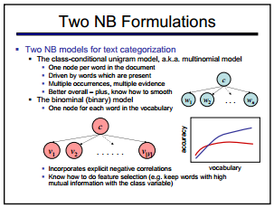
Estimating Probabilities
Courtesy Dan Klein

Slide 274
Example of Estimating Probabilities
United Nations
Politics
United States
Manchester United
Sports
Barca

Slide 275
Example of Multinomial Probabilities
United Nations
Politics
United States
Manchester United
Sports
Barca
P(United/Politics) = 1/2
P(Manchester/Sports) = 1/3
P(Nations/Politics) = 1/4
P(United/Sports) = 1/3
P(States/Politics) = 1/4
P(Barca/Sports) = 1/3
P(Politics) = 4/7
P(Sports) = 3/7

Slide 276
Example of Multinomial Probabilities
Politics?
United
Sports?
P(United/Politics) = 1/2
P(Manchester/Sports) = 1/3
P(Nations/Politics) = 1/4
P(United/Sports) = 1/3
P(States/Politics) = 1/4
P(Barca/Sports) = 1/3
P(Politics) = 4/7
P(Sports) = 3/7
P(Politics|United) = P(United|Politics)*P(Politics)
= (½)*(4/7) = 2/7
P(Sports|United) = P(United|Sports)*P(Sports)
= (1/3)*(3/7) = 1/7

Slide 277
Example of Bernoulli Probabilities
United Nations
Politics
United States
Manchester United
Sports
Barca
P(United/Politics) = 2/2
P(Manchester/Sports) = 1/2
P(Nations/Politics) = 1/2
P(United/Sports) = 1/2
P(States/Politics) = 1/2
P(Barca/Sports) = 1/2
P(Politics) = 2/4
P(Sports) = 2/4

Slide 278
Example of Bernoulli Probabilities
United
Politics?
Sports?
United !Nations !States !Barca !Manchester
P(United/Politics) = 2/2
P(Manchester/Sports) = 1/2
P(Nations/Politics) = 1/2
P(United/Sports) = 1/2
P(States/Politics) = 1/2
P(Barca/Sports) = 1/2
P(Politics) = 2/4
P(Sports) = 2/4
P(Sports|United) = P(U|S)*P(!M|S)*P(!B|S)*(!N/S)*(!S/S)*P(S)
= (1/2) *(1/2)*(1/2)*(1)*(1)*(2/4) = 1/32

Slide 279
Example of Bernoulli Probabilities
United
Politics?
Sports?
United !Nations !States !Barca !Manchester
P(United/Politics) = 2/2
P(Manchester/Sports) = 1/2
P(Nations/Politics) = 1/2
P(United/Sports) = 1/2
P(States/Politics) = 1/2
P(Barca/Sports) = 1/2
P(Politics) = 2/4
P(Sports) = 2/4
P(Politics|United) = P(U|P)*P(!N|P)*P(!S|P)*(!B|P)*(!M|P)/P(P)
= (2/2)*(1/2)*(1/2)*(1)*(1)*(2/4) = 2/32

Slide 280
Example of Estimating Probabilities
The United Nations
Politics
The United States and
Manchester United
Sports
Manchester and Barca

Slide 281
Example of Multinomial Probabilities
The United Nations
Politics
The United States and
Manchester United
Sports
Manchester and Barca
P(and/Politics) = 1/7
P(The/Politics) = 2/7
P(and/Sports) = 1/5
P(United/Politics) = 2/7
P(Manchester/Sports) = 2/5
P(Nations/Politics) = 1/7
P(United/Sports) = 1/5
P(States/Politics) = 1/7
P(Barca/Sports) = 1/5
P(Politics) = 7/12
P(Sports) = 5/12

Slide 282
Example of Multinomial Probabilities
Politics?
Nations and States
Sports?
P(and/Politics) = 1/7
P(The/Politics) = 2/7
P(and/Sports) = 1/5
P(United/Politics) = 2/7
P(Manchester/Sports) = 2/5
P(Nations/Politics) = 1/7
P(United/Sports) = 1/5
P(States/Politics) = 1/7
P(Barca/Sports) = 1/5
P(Politics) = 7/12
P(Sports) = 5/12
P(Politics|Nations,and,States) = P(Nations|P)*P(and|P)*P(States|Politics)*P(Politics)
= (1/7)*(1/7)*(1/7)*(7/12) = 1/(49*12)

Slide 283
Example of Multinomial Probabilities
Politics?
Nations and States
Sports?
P(and/Politics) = 1/7
P(The/Politics) = 2/7
P(and/Sports) = 1/5
P(United/Politics) = 2/7
P(Manchester/Sports) = 2/5
P(Nations/Politics) = 1/7
P(United/Sports) = 1/5
P(States/Politics) = 1/7
P(Barca/Sports) = 1/5
P(Politics) = 7/12
P(Sports) = 5/12
P(Sports|Nations,and,States) = P(Nations|S)*P(and|S)*P(States|Sports)*P(Sports)
= (0)*(1/5)*(0)*(5/12) = 0

Slide 284
Example of Multinomial Probabilities
Training
The United Nations
Politics
The United States and
Manchester United
Sports
Manchester and Barca
Test
Politics?
and United
Sports?

Slide 285
Example of Multinomial Probabilities
Politics?
and United
Sports?
P(and/Politics) = 1/7
P(The/Politics) = 2/7
P(and/Sports) = 1/5
P(United/Politics) = 2/7
P(Manchester/Sports) = 2/5
P(Nations/Politics) = 1/7
P(United/Sports) = 1/5
P(States/Politics) = 1/7
P(Barca/Sports) = 1/5
P(Politics) = 7/12
P(Sports) = 5/12
P(Politics|and,United) = ?

Slide 286
Example of Multinomial Probabilities
Politics?
and United
Sports?
P(and/Politics) = 1/7
P(The/Politics) = 2/7
P(and/Sports) = 1/5
P(United/Politics) = 2/7
P(Manchester/Sports) = 2/5
P(Nations/Politics) = 1/7
P(United/Sports) = 1/5
P(States/Politics) = 1/7
P(Barca/Sports) = 1/5
P(Politics) = 7/12
P(Sports) = 5/12
P(Politics|and,United) = P(and|P)*P(United|Politics)*P(Politics)
= ?

Slide 287
Example of Multinomial Probabilities
Politics?
and United
Sports?
P(and/Politics) = 1/7
P(The/Politics) = 2/7
P(and/Sports) = 1/5
P(United/Politics) = 2/7
P(Manchester/Sports) = 2/5
P(Nations/Politics) = 1/7
P(United/Sports) = 1/5
P(States/Politics) = 1/7
P(Barca/Sports) = 1/5
P(Politics) = 7/12
P(Sports) = 5/12
P(Politics|and,United) = P(and|P)*P(United|Politics)*P(Politics)
= (1/7)*(2/7)*(7/12) = 2/(7*12)

Slide 288
Example of Multinomial Probabilities
Politics?
and United
Sports?
P(and/Politics) = 1/7
P(The/Politics) = 2/7
P(and/Sports) = 1/5
P(United/Politics) = 2/7
P(Manchester/Sports) = 2/5
P(Nations/Politics) = 1/7
P(United/Sports) = 1/5
P(States/Politics) = 1/7
P(Barca/Sports) = 1/5
P(Politics) = 7/12
P(Sports) = 5/12
P(Sports|and,United) = P(and|S)*P(United|Sports)*P(Sports)
= (1/5)*(1/5)*(5/12) = 1/(5*12)

Slide 289
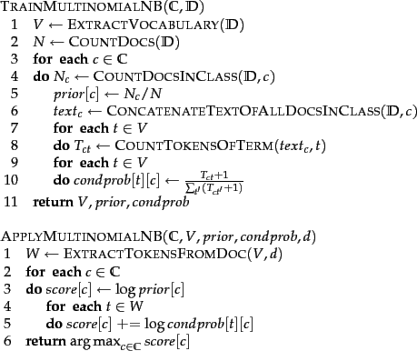
NB Multinomial
http://nlp.stanford.edu/IR-book/html/htmledition/naive-bayes-text-classification-1.html

Slide 290
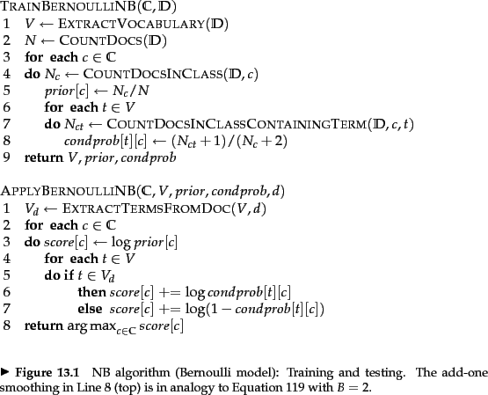
NB Multivariate Bernoulli
http://nlp.stanford.edu/IR-book/html/htmledition/the-bernoulli-model-1.html

Slide 291
Why Naïve Bayesian
One of the best classifiers known.
Can be learnt incrementally.
Learning is fast.

Slide 292
Problem with Naïve Bayesian Classifiers
The confidence values returned by the classifier i.e., P(C|features) cannot be trusted.
The classifier is always overconfident (it always places all its money on one class).
Given two classes A and B, say the classifier picks A, then usually P(A|features) > 0.9.
So you cannot use confidence thresholds

Slide 293
The imbalance grows with the number of features
United Nations
P(Sports|United Nations)
= P(United|S)*P(Nations|Sports)*P(Sports)
= (1/5)*(0)*(5/12) = 0
P(Politics|United Nations)
= P(United|P)*P(Nations|Politics)*P(Politics)
= (2/7)*(1/7)*(7/12) = 1/(7*6)

Slide 294
Maximum Entropy Classifier

Slide 295
Maximum Entropy Weights
Politics
UN
Adopts
Condemnation
Syria
Crackdown
Protests
Army
Hama
1.0
0.1
0.2
0.3
0.8
1.0
0.8
1.0
P(Politics|UN)
P(Politics|Adopts)
P(Politics|Condemnation)
P(Politics|Syria)
P(Politics|Crackdown)
P(Politics|Protests)
P(Politics|Army)
P(Politics|Hama)
Combined by weighted addition

Slide 296
How to calculate the P(C|F) directly
Linear Combination of Features
Take a set of features:
Words
Capitalization
Word context
Sub-words
Sentence length
Position in sentence
Multiply each by weights
Add up the products

Slide 297
Example from Text Categorization
“She served to win.”
Feature | Politics | Sports | Crime
serve | 1 | 1 | 1
serve+object(none) | 1 | 1 | 1
serve+object(years) | 0 | 0 | 0
Weights | Politics | Sports | Crime
serve | +1 | -0.3 | +1
serve+object(none) | -1.3 | +2.7 | -3.5
serve+object(years) | +0.7 | -4.5 | +2.3
Weights are learnt during training of the system!

Slide 298
Example from Text Categorization
“He served for 10 years as Secretary of State.”
Weights | Politics | Sports | Crime
serve | 1 * +1 | 1 * -0.3 | 1 * +1
serve+object(none) | 0 * -1.3 | 0 * +2.7 | 0 * -3.5
serve+object(years) | 0 * +0.7 | 0 * -4.5 | 0 * +2.3
serve+subcategori(for, years) | 1 * +1.5 | 1 * -1.5 | 1 * +0.3
serve+subcategorization(as) | 1 * +2.3 | 1 * -2 | 1 * -3.0
Total | 4.3 | -3.8 | -1.7
How do you learn the weights?

Slide 299
Training a Maximum Entropy Classifier
Adjust the weights w till you find one that maximizes the sum of the log posterior probabilities over the training data
Turns out this function is both differentiable and convex.
So, you can use convex optimization algorithms and do hill-climbing over the space of weights.
Courtesy Jurafsky

Slide 300
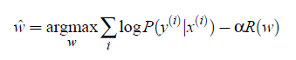
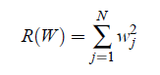
Regularization
In practice, you subtract a weight from the log posterior probabilities to keep the weights from heading off toward infinity !
Courtesy Jurafsky

Slide 301
How do you calculate P(y|x)?
P(y=true|x) = w * f ??? (can’t do this!!!)
Problem:
w * f not guaranteed to be a true probability
The product w*f ranges from +infinity to –infinity
So how do we convert w*f into a probability?

Slide 302
Converting From Real Numbers to Probabilities
w.f ranges from –inf to +inf.

Slide 303
Converting From Real Numbers to Probabilities
ranges from 0 to +inf.

Slide 304
Converting From Real Numbers to Probabilities
ranges from 1 to +inf.

Slide 305
Converting From Real Numbers to Probabilities
ranges from 0 to 1.
Wow! This could pass off as a probability!
Logistic function

Slide 306
Converting From Real Numbers to Probabilities
You can say
If it adds up to 1 for all y.

Slide 307
Converting From Real Numbers to Probabilities
It’s easy to make it add up to 1
You use a normalizer Z.

Slide 308
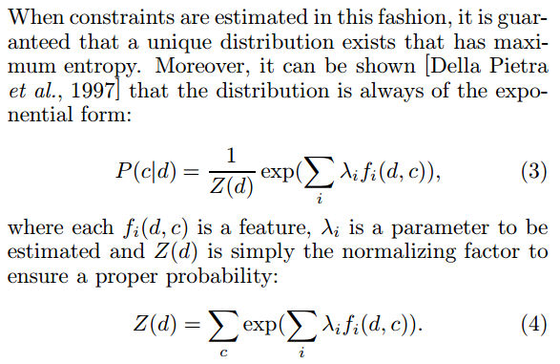
Why is it called MaxEnt?
It turns out that a distribution of the form satisfies maximum entropy constraints:

Slide 309
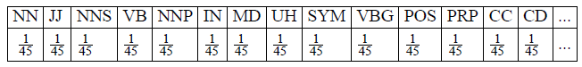
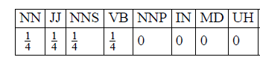
What does maximum entropy mean?
45 possible tags and no constraints:
When we know the right tag has to be one of the first four:

Slide 310
Why is it called Logistic Regression?
Because the following function is called the logistic function or logistic distribution:

Slide 311
Why is it called Logistic Regression?
Because the following function is called the logistic function or logistic distribution:
and training a maxent classifier is equivalent to doing regression using the logistic function.

Slide 312
What is Regression?
It’s like doing classification … in that you’re using a set of features x to predict a class y.
Except that, in regression, the class y is a real number.
Another name for regression is ‘curve fitting’.

Slide 313
What’s regression? Here’s an example
No. of vague adjectives | Extra Price Paid for House (above Asking Price)
3 | $1000
2 | $3000
1 | $9000
0 | $14,000
Use of words like fantastic, cute, charming indicates
that a house has no solid qualities (marble, furnished)!?
Levitt and Dubner 2005

Slide 314
What’s regression? Here’s an example
x | y
3 | $1000
2 | $3000
1 | $9000
0 | $14,000
Use of words like fantastic, cute, charming indicates
that a house has no solid qualities (marble, furnished)!?
Levitt and Dubner 2005

Slide 315
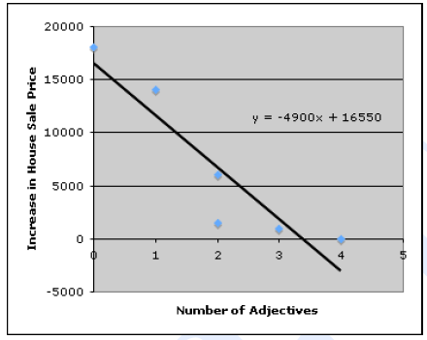
Regression
Courtesy of the textbook

Slide 316
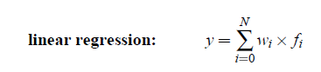
Regression is Curve Fitting
y = mx + c
also written as y = w1f1 + w0f0
f0 is a dummy feature
(linear combination of features using weights)
y = w.f
Courtesy the textbook

Slide 317
Solving a Linear Regression
It’s like solving for ‘m’ in ‘y = mx + c’
You can solve for ‘w’ in terms of ‘y’ and ‘w’ over the training data

Slide 318
Solving a Logistic Regression
It’s not as easy as solving for ‘m’ in ‘y = mx + c’
You have to hill-climb over:

Slide 319
Maximum Entropy Classifiers

Slide 320
Generative Model
category
text
source
P(c)
channel
P(t|c)
c
t
best
decoder
observed
c
t
argmax P(c|t) = argmax [ P(c)*P(t|c) ]
c
c
Using Bayesian Inversion

Slide 321
Discriminative Model
Calculate P(class|features) directly
best
decoder
observed
class
features
argmax P(class|features)
class

Slide 322
Classifiers Popular in Text Analytics
For most text analytics problems, you are deciding between one of three classifiers:
Statistical Methods
Generative Statistical Models
Naïve Bayesian Classifier
Discriminative Models
Maximum Entropy Classifiers
Non-Statistical
Support Vector Machines

Slide 323
Support Vector Machine Classifier

Slide 324
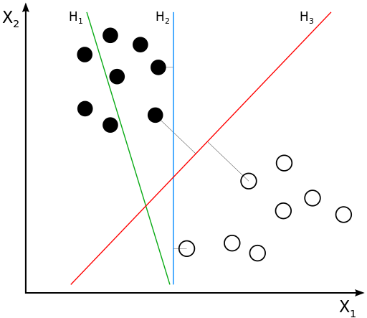
SVM Classifiers

Slide 325
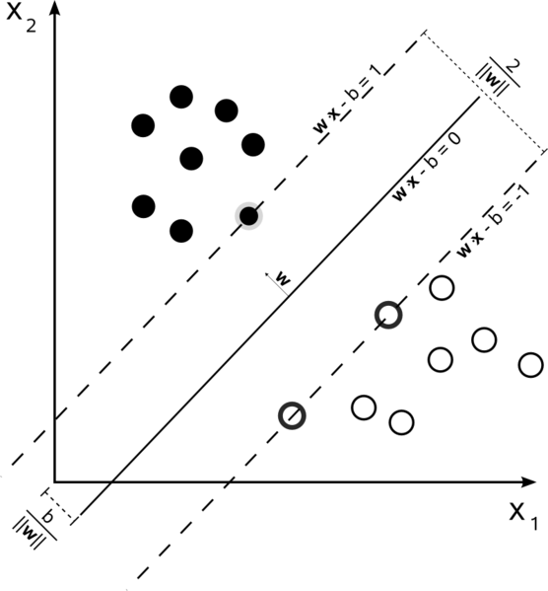
SVM Classifiers

Slide 326
SVM Classifiers

Slide 327
Time for Exercises!
Let’s practise!
Naïve Bayes classification
MaxEnt classification

Slide 328
Real world text analytics problem
How can you use text analytics to solve the following classification problem?
Classify the following jobs descriptions into:
full-time, part-time and contract

Slide 329
Real world text analytics problem
How can you use text analytics to solve the following classification problem?
Classify the following jobs descriptions into:
full-time, part-time and contract
Document 1: full-time, contract
Be willing to work in shifts (Morning Shift – 10 AM to 6 PM, and Afternoon – 2 PM to 10 PM), on a weekly rotational basis. Candidates shall be required to be based permanently in Mumbai for the tenure of their contract.

Slide 330
Real world text analytics problem
How can you use text analytics to solve the following classification problem?
Classify the following jobs descriptions into
full-time, part-time and contract as shown below:
Document 2: full-time, contract
The position is for the initial period of one year, and will be extended depending on performance. Please note that this is a full-time position.

Slide 331
Real world text analytics problem
How can you use text analytics to solve the following classification problem?
Classify the following jobs descriptions into:
full-time, part-time and contract
Document 3: full-time
Global Delivery ITO Network Services is responsible for the delivery of contracted network services to contracted outsourcing customers.
Full-time/Part-time: Full-time

Slide 332
Real world text analytics problem
How can you use text analytics to solve the following classification problem?
Classify the following jobs descriptions into:
full-time, part-time and contract
Document 4: full-time, part-time
Function: IT, Human Resources
Schedule: Full-time/Part-time postings available

Slide 333
Can you combine classifiers?
Can you combine classifiers to solve the problem?
If so, how?

Slide 334
One Versus All / One Versus Rest
Classifier 1: Politics vs Rest
Politics
Finance
Sports

Slide 335
One Versus All / One Versus Rest
Classifier 2: Finance vs Rest
Politics
Finance
Sports

Slide 336
One Versus All / One Versus Rest
Classifier 3: Sports vs Rest
Politics
Finance
Sports

Slide 337
One Versus All / One Versus Rest
Several Congress and BJP leaders are BCCI officer bearers. The BCCI has politicians like BJP's Arun Jaitley and ...
Politics
Sports
Finance
Possibly Classifier 1 decides it’s Politics
and Classifier 3 decides it’s Sports …

Slide 338
One Versus All / One Versus Rest
Several Congress and BJP leaders are BCCI officer bearers. The BCCI has politicians like BJP's Arun Jaitley and ...
Politics
Sports
Finance
Also possible Classifier 1 decides it’s not Politics
and Classifier 3 decides it’s not Sports and
Classifier 2 decides it’s not Finance

Slide 339
One Versus All / One Versus Rest
Several Congress and BJP leaders are BCCI officer bearers. The BCCI has politicians like BJP's Arun Jaitley and ...
Politics
Sports
Finance
Also possible Classifier 1 decides it’s not Politics
and Classifier 3 decides it’s not Sports and
Classifier 2 decides it’s not Finance … it’s NOTA

Slide 340
Multi-label Classification

Slide 341
Multiple Labels
How do you assign multiple categories or multiple labels to a data point?
This is the same as answering a multi-choice question.
So, you’re deciding that two answers are correct.

Slide 342
But remember …
Multilabel
is not
Multiclass

Slide 343
This is Multiclass
A document just has to be classified into one of these classes.
Politics
Sports
Finance

Slide 344
This is Multiclass
Just means there is more than one class.
But multiclass is usually used to denote more than 2 classes.
If there are only 2 classes, it is sometimes called binary classification.
Politics
Sports
Finance

Slide 345
Multilabel
A document may have to be classified into more than one of these classes.
Politics
Sports
Finance

Slide 346
Multilabel
Politics
Sports
Finance
The BCCI has politicians like BJP's Arun Jaitley and ...
On Day-One of the auction, Bangalore bought Sri Lankan Tillakaratne for

Slide 347
Measurement Exercise
Data Point | Real | Observed
D1 | Politics, Sports | Sports
D2 | Politics | Politics
D3 | Politics, Sports | Politics
D4 | Sports | Politics
D5 | Sports | Sports, Politics
D6 | Sports | Sports
D7 | Sports | Politics
D8 | Sports | Sports
What is the precision for Politics?

Slide 348
Measurement Exercise
Data Point | Real | Observed
D1 | Politics, Sports | Sports
D2 | Politics | Politics
D3 | Politics, Sports | Politics
D4 | Sports | Politics
D5 | Sports | Sports, Politics
D6 | Sports | Sports
D7 | Sports | Politics
D8 | Sports | Sports
What is the recall for Politics?

Slide 349
Measurement Exercise
Data Point | Real | Observed
D1 | Politics, Sports | Sports
D2 | Politics | Politics
D3 | Politics, Sports | Politics
D4 | Sports | Politics
D5 | Sports | Sports, Politics
D6 | Sports | Sports
D7 | Sports | Politics
D8 | Sports | Sports
What is the F-score for Politics?

Slide 350
Reuters Data Set
9603 training, 3299 test articles; ave. 200 words
118 categories
An article can be in more than one category
Learn 118 binary category distinctions
Common categories
(#train, #test)
Earn (2877, 1087)
Acquisitions (1650, 179)
Money-fx (538, 179)
Grain (433, 149)
Crude (389, 189)
Trade (369,119)
Interest (347, 131)
Ship (197, 89)
Wheat (212, 71)
Corn (182, 56)

Slide 351
AN EXAMPLE OF REUTERS TEXT DOCUMENT 14832
THAI TRADE DEFICIT WIDENS IN FIRST QUARTER
Thailand's trade deficit widened to 4.5
billion baht in the first quarter of 1987 from 2.1 billion a
year ago, the Business Economics Department said.
...
Export growth was smaller than expected due to lower
earnings from many key commodities including rice whose
earnings declined 18 pct, maize 66 pct, sugar 45 pct, tin 26
pct and canned pineapples seven pct.
Products registering high export growth were jewellery up
64 pct, clothing 57 pct and rubber 35 pct.
Categories: rubber tin sugar corn rice grain trade

Slide 352
THE REUTERS CATEGORIES FILE
test/14826 trade
test/14828 grain
test/14829 nat-gas crude
test/14832 rubber tin sugar corn rice grain trade
test/14833 palm-oil veg-oil

Slide 353
Multilabel Classification
We have our third design pattern:
Multilabel classification
When do you use it?
When data points can belong to more than one category.

Slide 354
Real world text analytics problem
Someone wants you to automatically evaluate essay answers for an English language test
Given an English sentence like:
It was the best of times; it was the worst of times; it was the age of wisdom; it was the age of foolishness.
Is this is a correct English sentence or not?
How do you measure the quality of a sentence?

Slide 355
Language Model
s = “the cat caught the mouse”
P(”the cat caught the mouse”) = P(“mouse”|”the cat caught the”)
*P(“the”|”the cat caught”)
*P(“caught”|”the cat”)
*P(“cat”|”the”)*P(“the”)
P(”the cat caught the mouse”) = P(“mouse”|”the”)
*P(“the”|”caught”)
*P(“caught”|”cat”)
*P(“cat”|”the”)*P(“the”)
P(“mouse”|”the cat caught the”) = P(“mouse”|”the”)

Slide 356
Language Model
Given: s = “the cat caught the mouse”
Come up with a function P(”the cat caught the mouse”) [aka the language model]
Such that P(.) has the following property …
Properties of a good language model:
P(“cat mouse the the caught”) << P(“the cat caught the mouse”)
P(“the banana ate the computer”) << P(“the man ate the banana”)

Slide 357
Language Model
Given: s = “the cat caught the mouse”
Come up with a function P(”the cat caught the mouse”) [aka the language model]
Such that P(.) has the following property …
Properties of a good language model:
P(“cat mouse the the caught”) << P(“the cat caught the mouse”)
P(“the banana ate the computer”) << P(“the man ate the banana”)
We will see that sequential models work best for this!

Slide 358
Language Model
We could start with the chain rule:
P(“FED”) = P(“F|ED”)*P(E|D)*P(D)
Proof?

Slide 359
Language Model
We could start with the chain rule:
P(“FED”) = P(“F|ED”)*P(E|D)*P(D)
Proof?
P(“FED”) = P(“F|ED”)*P(ED)
So,
P(“FED”) = P(“FED”)

Slide 360
Language Model
Using the chain rule:
P(“FED”) = P(“F|ED”)*P(E|D)*P(D)
You get:
P(”the cat caught the mouse”) = P(“mouse”|”the cat caught the”)
*P(“the”|”the cat caught”)
*P(“caught”|”the cat”)
*P(“cat”|”the”)*P(“the”)

Slide 361
Language Model
P(”the cat caught the mouse”) = P(“mouse”|”the cat caught the”)
*P(“the”|”the cat caught”)
*P(“caught”|”the cat”)
*P(“cat”|”the”)*P(“the”)
the
cat
caught
the
mouse

Slide 362
Problem of Over-fitting
Say C(“the cat caught the mouse”) = 1
Say C(“the cat caught the”) = 1
You get P(“mouse”|”the cat caught the”) = 1

Slide 363
One Solution for Over-fitting
Use a smaller model (make a Markov assumption)
Example: Unigrams
P(“caught the”) = P(“the|caught”)P(“caught”)
= P(“the”)P(“caught”)

Slide 364
Big problem with unigrams
P(“the the the the”) > P(“I like ice cream”)
P(“I an”) > P(“I am”)

Slide 365
Another solution - Bigrams
P(“caught the”) = P(“caught”|<s>)P(“the”|“caught”)
<s> stands for start of sentence

Slide 366
Markov Assumption
Your memory of history is limited.
Say your memory of history is 1.
The equation P(“FED”) = P(“F|ED”)*P(E|D)*P(D) becomes
P(“FED”) = P(“F|E”)*P(E|D)*P(D)
You get:
P(”the cat caught the mouse”) = P(“mouse”|”the cat caught the”)
*P(“the”|”the cat caught”)
*P(“caught”|”the cat”)
*P(“cat”|”the”)*P(“the”)

Slide 367
Language Model – with Markov Assumption
P(”the cat caught the mouse”) = P(“mouse”|”the”)
*P(“the”|”caught”)
*P(“caught”|”cat”)
*P(“cat”|”the”)
*P(“the”)
the
cat
caught
the
mouse
Formalism 1

Slide 368
So, let’s try bigrams
P(“the the the the”) < P(“I like ice cream”)
P(“I an”) < P(“I am”)
So far, so good!
P(I saw a van) >> P(eyes awe of an)
P(artichokes intimidate zippers) ≈ 0
Nice!

Slide 369
Language Model – Parameters
P(”the cat caught the mouse”) = P(“mouse”|”the”)
*P(“the”|”caught”)
*P(“caught”|”cat”)
*P(“cat”|”the”)
*P(“the”)
the
cat
caught
the
mouse
The features are the words … in this case, “the”, “cat”, etc.
The p(feature|previous feature) are the parameters (transition probabilities).

Slide 370
Visible Markov Model
q5:a
a52
q2:cat
a12
a23
q1:the
q3:caught
a31
a14
q4:mouse
States: q1 q2 q3
Start states: q1 q5
End states: q4
Transition Probabilities: A = {a11 a12 a13 a14 …}
Initial Probabilities: P = {p1 p5}

Slide 371
Language Model – with Markov Assumption
P(”the cat caught the mouse”) = P(“mouse”|”the”)
*P(“the”|”caught”)
*P(“caught”|”cat”)
*P(“cat”|”the”)
*P(“the|<start>”)
<s>
the
cat
caught
the
mouse
</s>
Formalism 2

Slide 372
Visible Markov Model
q5:a
a52
q2:cat
qs:<s>
a12
a23
q1:the
q3:caught
a31
a14
qe:</s>
q4:mouse
States: q1 q2 q3 …
Start state: qs
End state: qe
Transition Probabilities: A = {a11 a12 a13 a14 …}
Initial Probabilities: P = {p1 p5}

Slide 373
How do you train a Language Model
as1 = ?
as5 = ?
a12 = ?
a14 = ?
q5:a
Model 1 = c1
a52
q2:cat
qs:<s>
as5
a12
a23
as1
q3:caught
q1:the
a31
a4e
a14
qe:</s>
q4:mouse
Sentences:
A cat caught the mouse
The cat caught the mouse
The mouse

Slide 374
Language Model – with Markov Assumption
Evaluation
Given model m and observations O, what is P(O|m)
Let’s say the observations are “the mouse”

Slide 375
Language Model – What is the Probability of a Sentence
as1 = 0.2
as5 = 0.8
a12 = 0.5
a14 = 0.5
other axy = 1
q5:a
Model 1
a52
q2:cat
qs:<s>
as5
a12
a23
as1
q3:caught
q1:the
a31
a4e
a14
qe:</s>
q4:mouse
Sentence: The mouse

Slide 376
Language Model – What is the Probability of a Sentence
as1 = 0.2
as5 = 0.8
a12 = 0.5
a14 = 0.5
other axy = 1
q5:a
Model 1
a52
q2:cat
qs:<s>
as5
a12
a23
as1
q3:caught
q1:the
a31
a4e
a14
qe:</s>
q4:mouse
Sentence: The mouse
P(s) = as1 * a14 * a4e
= ?

Slide 377
Language Model – What is the Probability of a Sentence
as1 = 0.2
as5 = 0.8
a12 = 0.5
a14 = 0.5
other axy = 1
q5:a
Model 1
a52
q2:cat
qs:<s>
as5
a12
a23
as1
q3:caught
q1:the
a31
a4e
a14
qe:</s>
q4:mouse
Sentence: The mouse
P(s) = as1 * a14 * a4e
= 0.2*0.5*1 = 0.1

Slide 378
Language Model – What is the Probability of a Sentence
as1 = 0.8
as5 = 0.2
a12 = 0.5
a14 = 0.5
other axy = 1
q5:a
Model 2
a52
q2:cat
qs:<s>
as5
a12
a23
as1
q3:caught
q1:the
a31
a4e
a14
qe:</s>
q4:mouse
Sentence: The mouse
P(s) = as1 * a14 * a4e
= 0.8*0.5*1 = 0.4

Slide 379
Language Model – What is the Probability of a Sentence
You try the sentence:
The cat caught the mouse

Slide 380
as1 = 0.2
as5 = 0.8
a12 = 0.5
a14 = 0.5
other axy = 1
q5:a
Model 1
a52
q2:cat
qs:<s>
as5
a12
a23
as1
q3:caught
q1:the
a31
a4e
a14
qe:</s>
q4:mouse
as1 = 0.8
as5 = 0.2
a12 = 0.5
a14 = 0.5
other axy = 1
q5:a
Model 2
a52
q2:cat
qs:<s>
as5
a12
a23
as1
q1:the
q3:caught
a31
a4e
a14
qe:</s>
q4:mouse

Slide 381
as1 = 0.2
as5 = 0.8
a12 = 0.5
a14 = 0.5
other axy = 1
q5:a
Model 1
a52
q2:cat
qs:<s>
as5
a12
a23
as1
q3:caught
P(s) = as1 * a12
* a23 * a31 * a14 * a4e
q1:the
a31
a4e
a14
qe:</s>
q4:mouse
as1 = 0.8
as5 = 0.2
a12 = 0.5
a14 = 0.5
other axy = 1
q5:a
Model 2
a52
q2:cat
qs:<s>
as5
a12
a23
as1
q1:the
q3:caught
P(s) = as1 * a12 * a23 * a31 * a14 * a4e
a31
a4e
a14
qe:</s>
q4:mouse

Slide 382
as1 = 0.2
as5 = 0.8
a12 = 0.5
a14 = 0.5
other axy = 1
q5:a
Model 1
a52
q2:cat
qs:<s>
as5
a12
a23
as1
q3:caught
P(s) = as1 * a12
* a23 * a31 * a14 * a4e
= 0.2*0.5*1*1*0.5*1 = 0.05
q1:the
a31
a4e
a14
qe:</s>
q4:mouse
as1 = 0.8
as5 = 0.2
a12 = 0.5
a14 = 0.5
other axy = 1
q5:a
Model 2
a52
q2:cat
qs:<s>
as5
a12
a23
as1
q1:the
q3:caught
P(s) = as1 * a12
* a23 * a31 * a14 * a4e
= 0.8*0.5*1*1*0.5*1 = 0.2
a31
a4e
a14
qe:</s>
q4:mouse

Slide 383
Why is multiplying by 0 bad?
Assume ‘Vishwanathan’ is not in the corpus.
C(“met Vishwanathan”) = 0
C(“met”) ~= 30000
Unigram
P(“met Vish..”) = P(“met”)P(“Vish..”)
= 0.0004 * 0
Bigram
P(“met Vish..”) = P(“met”|…)P(“Vish..”|”met”)
= 0.023 * 0
Problem of Unknown words
kills other estimates!

Slide 384
Quick puzzle
What’s the usual part of speech of unknown words?
Examples of Part of Speech:
Verbs, Adjectives, Adverbs, Conjunctions, Common Nouns,
Proper Nouns, Definite Articles, Indefinite Articles
Classes of Words:
Closed – pronouns, prepositions, particles (function words)
Open – nouns, verbs, adjectives (content words)

Slide 385
SMOOTHING
Laplace, Lidstone, Jeffreys-Perks
Witten-Bell
Good-Turing
Katz’s Backoff
Kneser-Ney
Linear Interpolation

Slide 386
Definitions
Word types
Word tokens
N: size of corpus [count tokens]
V: size of vocabulary [count types]
B: parameter size of the model
unigram B=V
bigram B=V²
trigram B=V³
n-gram B=V^{n}
C(w₁...w_{n}) is the count of an n-gram
Ct is the count of word wt
N_{r}: The number of n-grams with count r

Slide 387
LAPLACE SMOOTHING
Unigrams:

Slide 388
LAPLACE SMOOTHING
Google Terabyte Corpus

Slide 389
LAPLACE SMOOTHING
Brown Corpus Unigrams

Slide 390
LAPLACE SMOOTHING
Brown Corpus Bigrams
56057*56057=3.1423*1,000,000,000

Slide 391
LAPLACE SMOOTHING
Brown Corpus
Conditional Probabilities

Slide 392
LIDSTONE’s

Slide 393
JEFFREY-PERK’s

Slide 394
Language Model – Challenge
Can you build a classifier out of a language model?

Slide 395
Language Model – Challenge
Can you build a classifier out of this?
You just calculated P(s)
For classification you need to compute P(c|s)

Slide 396
Language Model – Challenge
Can you build a classifier out of this?
You just calculated P(s)
For classification you need to compute P(c|s)
Use Bayesian Inversion!!!

Slide 397
Language Model – Challenge
as1 = 0.2
as5 = 0.8
a12 = 0.5
a14 = 0.5
other axy = 1
q5:a
Model 1 = c1
a52
q2:cat
qs:<s>
as5
a12
a23
as1
q3:caught
P(s) = as1 * a12
* a23 * a31 * a14 * a4e
= 0.2*0.5*1*1*0.5*1 = 0.05
q1:the
a31
a4e
a14
qe:</s>
q4:mouse
P(c|s) = P(s|c) * P(c) / P(s)
P(c|s) = as1 * a12
* a23 * a31 * a14 * a4e * P(c) / P(s)

Slide 398
Chomsky’s Disagreement
In 1969 he wrote:
But it must be recognized that the notion of "probability of a sentence" is an entirely useless one, under any known interpretation of this term.

Slide 399
Chomsky’s Argument
A completely new sentence must have a probability of 0, since it is an outcome that has not been seen.
Since novel sentences are in fact generated all the time, there is a contradiction.

Slide 400
Language Model – Challenge
Defend the notion of the probability of a sentence
against Chomsky

Slide 401
UNKNOWN SENTENCE
P(“Cohan is short”)
=
P(“short” | “is”) * P(“is” | “Cohan”) * P(“Cohan”)
=
C(“is short”)/C(“is”)
* C(“Cohan is”)/C(“Cohan”)
* C(“Cohan”)/C(“*”)

Slide 402
Solved!

Slide 403
Real world text analytics problem
Someone wants you to build a tool to improve the quality of their OCR system
Their OCR recognizes words incorrectly
times -> +imes
makes -> make5
Can you correct these mistakes?

Slide 404
Spell Checking
Let’s say the word ‘hand’ is mistyped
Hand --- *Hamd
There you have an unknown word!

Slide 405
Spell Checking
Out-of-Vocabulary Error
*Hamd

Slide 406
Spell Checking
*Hamd
Hand
Hard

Slide 407
What we need to find …
P(hard|hamd)
P(hand|hamd)
Whichever is greater is the right one!

Slide 408
What we need to find …
But how do you find the probability P(hard|hamd) when ‘hamd’ is an *unknown word*?
This is related to Chomsky’s conundrum of the unknown sentence, isn’t it?

Slide 409
BAYES RULE
Conditional Prob:
P(FE) = P( F|E ) * P (E)
P(EF) = P( E|F ) * P (F)
P(E|F) = P(F|E) * P(E) / P(F)

Slide 410
BAYES RULE
P(E|F) = P(F|E) * P(E) / P(F)
P(hand|hamd) = P(hamd|hand)*P(hand)/P(hamd)

Slide 411
Make a Massive Independence Assumption
P(hamd|hand) = P(h|h)P(a|a)P(m|n)P(d|d)

Slide 412
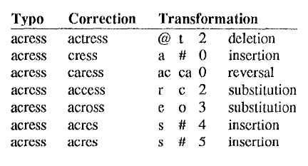
Kernighan’s paper on spell correction 1990

Slide 413
BAYES RULE
P(E|F) = P(F|E) * P(E) / P(F)
P(hand|hamd) = P(hamd|hand)*P(hand)/Z
P(hamd|hand) = P(h|h)P(a|a)P(m|n)P(d|d)
P(hand|hamd) = P(m|n)*P(hand)/Z
The stuff in green is approximately 1, so ignore it!

Slide 414
So we have what we needed to find …
P(hard|hamd) = P(m|n)*P(hand)/Z
P(hand|hamd) = P(m|r)*P(hard)/Z
Whichever is greater is the right one!

Slide 415
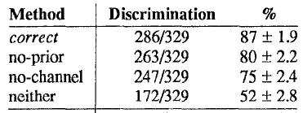
Note: Use of Unigram Probabilities
The P(m|n) part is called the channel probability
The P(hand) part is called the prior probability
Kernighan’s experiment showed that P(hand) is very important (causes a 7% improvement)!

Slide 416
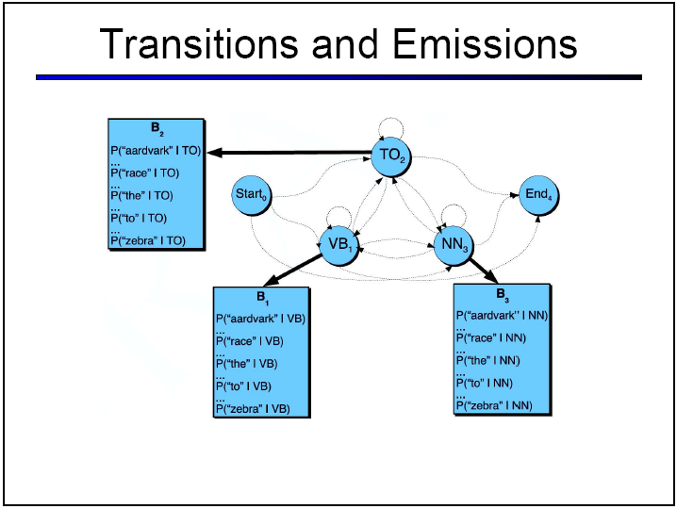
Hidden Markov Model (HMM)
Courtesy of the textbook

Slide 417
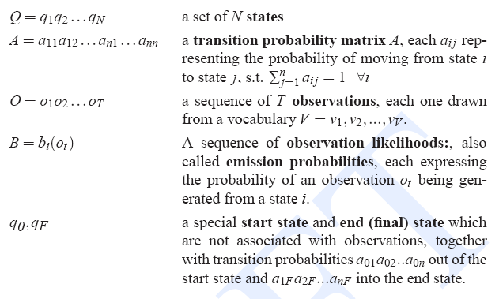
Formalism
Hidden Markov Model (HMM)
Courtesy of the textbook – Jurafsky and Martin

Slide 418
Hidden Markov Model (HMM)
o3:cat
mouse4
b23
b24
qs:<s>
a12
a23
caught5
as1
q2:NN
b35
q1:DT
a31
q3:VBD
b11
b12
a4e
o1:the
o2:a
qe:</s>
States: q1 q2 q3 …
Start, end states: qs, qe
Representation 1: trained model
Observations: o1 o2 o3 …
Transition Probabilities: A = {a11 a12 a13 a14 …}
Emission Probabilities: B = {bij …}

Slide 419
How do you train an HMM
as1 = ?
a12 = ?
a31 = ?
B23 = ?
B24 =?
o3:cat
o4:mouse
Model 1 = c1
b23
b24
qs:<s>
a12
a23
o5:caught
as1
q2:NN
b35
q1:DT
a31
q3:VBD
b11
b12
a2e
o1:the
o2:a
qe:</s>
Transition Probabilities: A = {as1 a12 a23 a31 …}
Emission Probabilities: B = {bij …}
Sentences:
A/DT cat/NN caught/VBD the/DT mouse/NN
The/DT cat/NN caught/VBD the/DT mouse/NN
The/DT mouse/NN

Slide 420
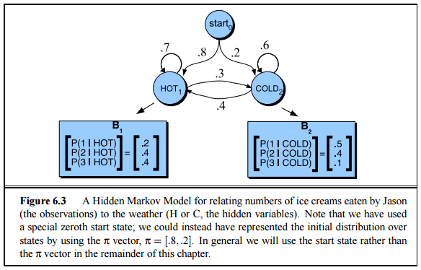
Example of a Trained HMM Model
Courtesy the textbook Jurafsky and Martin

Slide 421
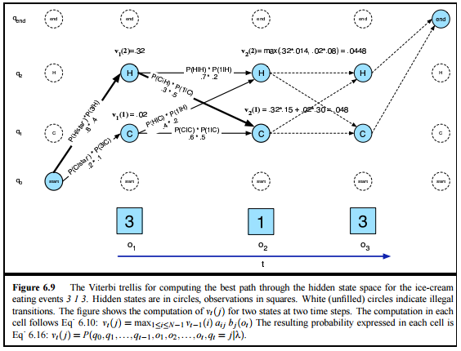
Decoding Problem Example
Courtesy the textbook Jurafsky and Martin

Slide 422
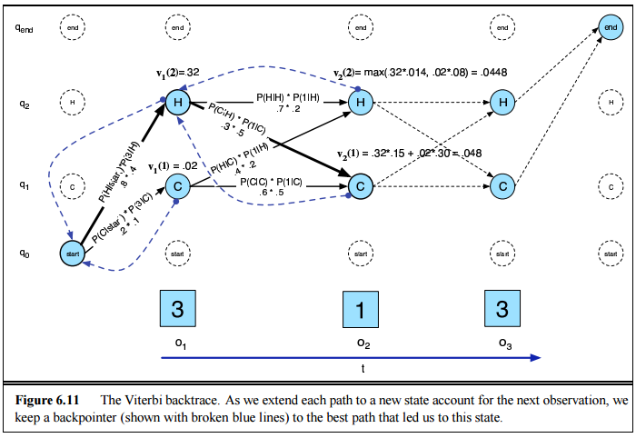
Back-Pointers
Courtesy the textbook Jurafsky and Martin

Slide 423
HMMs as a Decoder for POS Tagging
Sentence:
A cat caught the mouse
Decoded hidden states:
DT NN VBD DT NN

Slide 424
HMM transitions and emissions
Courtesy of Dan Klein

Slide 425
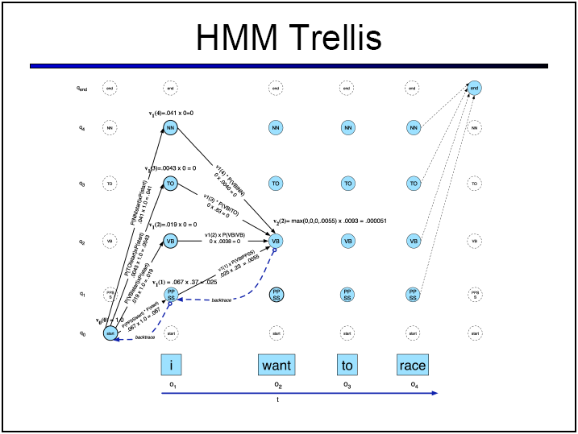
TRELLIS
Courtesy of Dan Klein

Slide 426
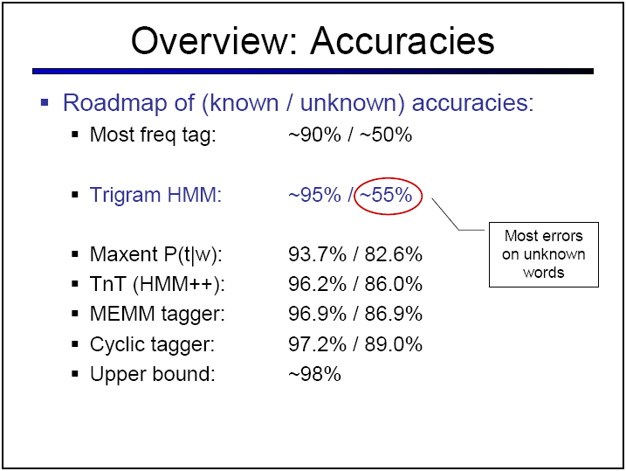
BASELINES
Courtesy of Dan Klein

Slide 427
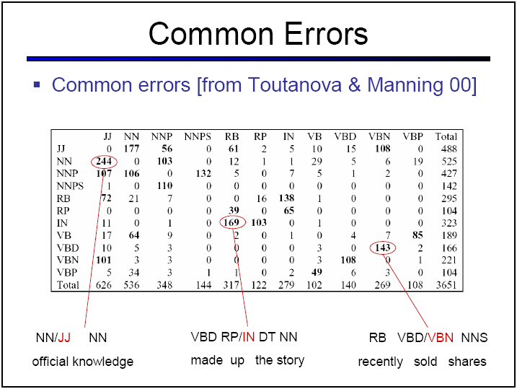
ERROR ANALYSIS
Courtesy of Dan Klein

Slide 428
HMMs as a Decoder for NER
Sentence:
John bought a Maruti in Bangalore
Decoded hidden states:
Person Other Other Vehicle Other Place

Slide 429
HMM – Evaluation
Can you calculate P(s) using an HMM trained as a POS tagger?
For evaluation (computing the probability of a sequence of observations) you need to use the ‘Forward algorithm’.

Slide 430
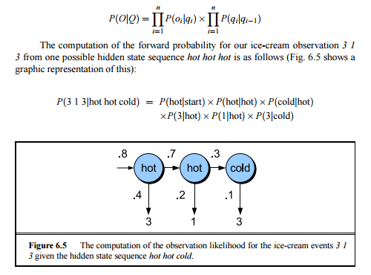
HMM – If you knew the hidden states
Courtesy the textbook Jurafsky and Martin

Slide 431
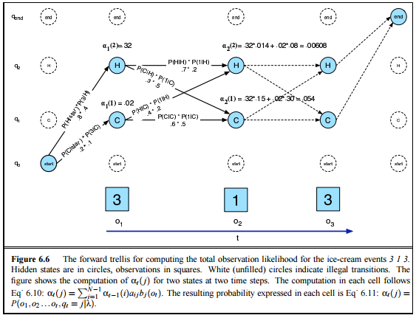
HMM – Forward Algorithm
Courtesy the textbook Jurafsky and Martin

Slide 432
HMM Model – Challenge
Can you build a classifier out of this?
You just calculated P(s)
For classification you need to compute P(c|s)
Use Bayesian Inversion!!!

Slide 433
HMM – Challenge
as1 = ?
a12 = ?
a31 = ?
B23 = ?
B24 =?
o3:cat
o4:mouse
Model 1 = c1
Model 1 = c1
b23
b24
qs:<s>
a12
a23
o5:caught
as1
q2:NN
b35
q1:DT
a31
q3:VBD
b11
b12
a2e
o1:the
o2:a
qe:</s>
Transition Probabilities: A = {as1 a12 a23 a31 …}
Emission Probabilities: B = {bij …}
P(c|s) = P(s|c) * P(c) / Z
P(c|s) = forward_algorithm(s, hmm_for_c) * P(c) / Z

Slide 434
HMM – Challenge
Can you build a relation extractor out of HMMs?

Slide 435
HMMs as a Classifier for RelEx
Train HMM1 on Sentences:
Tim/P Cook/P is the CEO of Apple/O
Vishal/P Sikka/P is the CEO of Infosys/O
Train HMM2 on Sentences:
Bangalore/L is the capital of Karnataka/L
Delhi/L is the capital of India/L

Slide 436
HMMs as a Classifier for RelEx
Now, given a new sentence:
“Frank is the CEO of Cognizant”
See if P(C|S) is higher with HMM1 or HMM2
Ignoring P(C), you can just see if P(“Frank is the CEO of Cognizant”) is higher for HMM1 or HMM2.

Slide 437
Sequential Pattern Mining for Text Analytics
Cohan Sujay Carlos
Aiaioo Labs
Bangalore, India
cohan@aiaioo.com

Slide 438
Feature Level Sentiment Analysis
M. Hu and B. Liu, “Mining opinion features in customer reviews,” in Proceedings of AAAI, pp. 755–760, 2004.
A.-M. Popescu and O. Etzioni, “Extracting product features and opinions from reviews,” in Proceedings of the Human Language Technology Conference and the Conference on Empirical Methods in Natural Language Processing (HLT/EMNLP), 2005.

Slide 439
Sentiment in Comparative Sentences
N. Jindal and B. Liu, “Identifying comparative sentences in text documents,” in Proceedings of the ACM Special Interest Group on Information Retrieval (SIGIR), 2006.
N. Jindal and B. Liu, “Mining comparative sentences and relations,” in Proceedings of AAAI, 2006.
Murthy Ganapathibhotla and Bing Liu. "Mining Opinions in Comparative Sentences." Proceedings of the 22nd International Conference on Computational Linguistics (Coling-2008), Manchester, 18-22 August, 2008.

Slide 440
Identifying intentions might help sentiment analysis?
Inquire Intention
Example 1: “Is the Canon EOS 5 a good camera?”
What clues do you have that this is an inquiry?

Slide 441
Identifying intentions might help sentiment analysis?
Inquire Intention
Example 1: “Is the Canon EOS 5 a good camera?”
What clues do you have that this is an inquiry?
Is the Canon EOS 5 a good camera?

Slide 442
Identifying intentions might help sentiment analysis?
Purchase Intention
Example 2: “I want a good Canon camera”
What are the clues that there is buy intention?

Slide 443
Identifying intentions might help sentiment analysis?
Purchase Intention
Example 2: “I want a good Canon camera”
What are the clues that there is buy intention?
I want a good Canon camera

Slide 444
Identifying intentions might help sentiment analysis?
Direct Intention
Example 3: “Take me to a good movie.”
What tell us that this is a directive?
Take me to a good movie

Slide 445
The kind of features we need
Is the Canon EOS 5 a good camera?
I want a good Canon camera
Take me to a good movie
Unigrams – ‘?’
Bigrams – “Is it” instead of “It is”
At the end of a sentence … (How do you encode whether a word is at the end of a sentence?)

Slide 446
The kind of features we need
Is the Canon EOS 5 a good camera?
I want a good Canon camera
Take me to a good movie
Unigrams – ‘?’
Bigrams – “Is it” instead of “It is”
At the end of a sentence … (How do you encode whether a word is at the end of a sentence?)

Slide 447
The kind of features we need
At the end of a sentence … (How do you encode whether a word is at the end of a sentence?)
<s> Is the Canon EOS 5 a good camera? </s>
<s> I want a good Canon camera </s>
<s> Take me to a good movie </s>

Slide 448
Class Sequential Rule
Sequence of symbols i₁ – i_{n} that matches text in which the symbols appear in that order
Example, I = < i₁ i₂ i₃ > where i₁ i₂ i₃ are unigrams
Matches: Does not match:
A i₁ B i₂ C D i₃ E A B i₂ i₁ C D i₃ E
i₁ i₂ R S i₃ A B i₂ C D i₃ E
i₁ i₂ i₃ M N

Slide 449
Class Sequential Rule
Placeholders x_{i} – x_{n} among the symbols i₁ – i_{n} that match text between the symbols on either side
Example, I = < i₁ i₂ x₁ i₃ > where i₁ i₂ i₃ are unigrams
When I matches A i₁ B i₂ C D i₃ E --- x₁ equals ’C D’
When I matches i₁ i₂ R S i₃ --- x₁ equals ’R S’
When I matches i₁ i₂ i₃ M N --- x₁ equals ’’

Slide 450
Class Sequential Rules
Capabilities of the formalism:
Identify types of sentences
Extract entities from those sentences
Mapping to Natural Language Programming:
Types = programming primitives
Entities = variables, literals and expressions

Slide 451
Example
S = increment the value of x by 2 * 3
I₁ = < increment of VARIABLE by EXPRESSION >
I₁ matches S: increment the value of x by 2 * 3
VARIABLE = ‘x’
EXPRESSION = ‘2 * 3’

Slide 452
Example Continued
E = 2 * 3 (* 2 3)
I₂ = < EXPRESSION * EXPRESSION >
I₂ matches E: 2 * 3
EXPRESSION = ‘2’
EXPRESSION = ‘3’

Slide 453
Example Continued
Mapping to Natural Language Programming:
Types = programming primitives
Entities = variables, literals and expressions
increment the value of x by 2 * 3
(+= x (* 2 3))
Class Sequential Rules

Slide 454
How do you learn CSRs?
Bangalore, India

Slide 455
Frequent Itemset Mining
Bangalore, India

Slide 456
Discovering Patterns for Relation Extraction
Corpus
Pattern Extraction
Patterns

Slide 457
Discovering Patterns
Corpus of inquiries:
1: Is the Canon 5 a good camera?
2: Is Pune close to Mumbai?
3: Is the moon made of cheese?
Find the frequent patterns in all these inquiries.

Slide 458
Discovering Patterns
Corpus of inquiries:
1: Is the Canon 5 a good camera?
2: Is Pune close to Mumbai?
3: Is the moon made of cheese?
Find the frequent patterns in all these inquiries.

Slide 459
Discovering Patterns
Corpus of inquiries:
1: Is the Canon 5 a good camera?
2: Is Pune close to Mumbai?
3: Is the moon made of cheese?
Find the frequent patterns in all these inquiries.
Is the ?
Is ?

Slide 460
Discovering Patterns
Corpus of inquiries:
1: Is the Canon 5 a good camera?
2: Is Pune close to Mumbai?
3: Is the moon made of cheese?
Frequent Patterns:
Is the ?
Is ?
Why are these the frequent patterns?

Slide 461
Support
Support is the number of times a pattern appears in a corpus:
1: Is the Canon 5 a good camera?
2: Is Pune close to Mumbai?
3: Is the moon made of cheese?
Frequent Patterns are patterns whose support exceeds a threshold (minsup) = 2 in this case:
Is the ?
Is ?

Slide 462
Support
Support for a pattern in this corpus:
1: Is the Canon 5 a good camera?
2: Is Pune close to Mumbai?
3: Is the moon made of cheese?
Is the ? (support = 2)
Is ? (support = 3)

Slide 463
Algorithm for extracting frequent patterns
1: Generate patterns
2: Throw out all patterns that do not have the required support

Slide 464
Algorithm for extracting frequent patterns
1: Generate patterns
But there are a lot of patterns
2: Throw out all patterns that do not have the required support
But this requires evaluating every single
pattern by counting all the documents in
the corpus that it matches, which is
expensive.

Slide 465
Brute-force algorithm for extracting frequent patterns
1: Generate all patterns of a given length
2: Discard those with less support than minsup in the corpus

Slide 466
Algorithm for extracting frequent patterns
Patterns in this corpus:
1: Is the Canon 5 a good camera?
2: Is Pune close to Mumbai?
3: Is the moon made of cheese?
1: Generate all patterns of length 1
Is, the, Canon, 5, a, good, camera, ?, Pune, close, to, Mumbai, moon, made, of, cheese

Slide 467
Algorithm for extracting frequent patterns
Patterns in this corpus:
1: Is the Canon 5 a good camera?
2: Is Pune close to Mumbai?
3: Is the moon made of cheese?
2: Generate all patterns of length 2 from the patterns of length 1
<Is, the>, <is, Canon>, <is,5>, <is, a> … <the, Canon>, <the, 5> … <Canon, 5>, <Canon, a>

Slide 468
Algorithm for extracting frequent patterns
Patterns in this corpus:
1: Is the Canon 5 a good camera?
2: Is Pune close to Mumbai?
3: Is the moon made of cheese?
3: Generate all patterns of length 3 from the patterns of length 2
<Is, the, Canon>, <Is, the, 5>, <Is, the, a>, <is, Canon, 5>, <is, Canon, a> <is,5, a>

Slide 469
Algorithm for extracting frequent patterns
Patterns in this corpus:
1: Is the Canon 5 a good camera?
2: Is Pune close to Mumbai?
3: Is the moon made of cheese?
4: Generate all patterns of length 4 from the patterns of length 3
<Is, the, Canon, 5>, <Is, the, Canon, a>, <Is, the, Canon, the>, <the, Canon, 5, a>, <the, Canon, a, good>

Slide 470
Algorithm for extracting frequent patterns
Patterns in this corpus:
1: Is the Canon 5 a good camera?
2: Is Pune close to Mumbai?
3: Is the moon made of cheese?
So if you have 10000 possible patterns and a corpus of 10000 documents, you end up having to do 100 million matches in order to calculate support and select only the frequent patterns whose counts exceed the minsup value.

Slide 471
Algorithm for extracting frequent patterns
Patterns in this corpus:
1: Is the Canon 5 a good camera?
2: Is Pune close to Mumbai?
3: Is the moon made of cheese?
So you use a variant of the A-priori algorithm which was originally developed for frequent itemset mining.

Slide 472
Frequent Itemsets
Retail transactions:
1: <milk, eggs, bread, sugar>
2: <coffee, milk, eggs, magazine>
3: <milk, bread, eggs>
Frequent itemsets:
milk, eggs, bread
milk, eggs

Slide 473
How do you find the Frequent Itemsets
Retail transactions:
1: <milk, eggs, bread, sugar>
2: <coffee, milk, eggs, magazine>
3: <milk, bread, eggs>
Generate all itemsets
Throw out all itemsets that don’t have the minsup (minimum support) in the corpus.

Slide 474
Generating the Frequent Itemsets
Generate itemsets of size 1
a
b
c

Slide 475
Generating the Frequent Itemsets
Generate itemsets of size 2
a
b
c
a,b
a, c
b,c

Slide 476
Generating the Frequent Itemsets
Generate itemsets of size 3
a
b
c
a,b
a, c
b,c
a, b, c

Slide 477
Generating the Frequent Itemsets
You can consider a smaller set of candidates if you prune this graph
a
b
c
a,b
a, c
b,c
a, b, c

Slide 478
Generating the Frequent Itemsets
Let’s say “a” does not have the requisite support.
a
b
c
a,b
a, c
b,c
a, b, c

Slide 479
Generating the Frequent Itemsets
Then all length 2 itemsets containing “a” also do not have the requisite support.
a
b
c
a,b
a, c
b,c
a, b, c

Slide 480
Generating the Frequent Itemsets
All length 3 itemsets containing “a” also do not have the requisite support.
a
b
c
a,b
a, c
b,c
a, b, c

Slide 481
The Frequent Itemsets
Now we have the frequent itemsets.
b
c
b,c

Slide 482
The Frequent Itemsets
These can be used to generate the rule:
Now test the confidence of the rule (the % of the time the rule holds in the corpus) to decide if the rule is a good one.
b -> c

Slide 483
The Frequent Itemsets
You can also generate:
Age > 20 and Gender Male -> Online Buyer
b -> c

Slide 484
Common Pattern Specification Language
Cohan Sujay Carlos
Aiaioo Labs
Bangalore, India
cohan@aiaioo.com

Slide 485
Rule-Based Information Extraction
THE COMMON PATTERN SPECIFICATION LANGUAGE - Douglas E. Appelt

Slide 486
What is CPSL?
Designed as a language for specifying finite-state grammars for specifying information extraction rules

Slide 487
Why CPSL?
Meant to “enable the creation of shareable resources for the development of rule-based information extraction systems”

Slide 488
Where CPSL?
Designed as a language for “systems based on the knowledge engineering approach of developing sets of rules more or less by hand, targeted toward specific subjects.”

Slide 489
Who designed CPSL?
The CPSL was designed by a committee consisting of a number of researchers from the Government and all of the TIPSTER research sites involved in Information Extraction.

Slide 490
How CPSL?
Assume a reference interpreter ...
It has a reference pointer that starts out pointed at the first word in a document then runs through the document as matching is done, and ends at the last word.

Slide 491
How CPSL?
Assume a reference interpreter ...
It has a reference pointer that starts out pointed at the first word in a document then runs through the document as matching is done, and ends at the last word.

Slide 492
How CPSL?
Assume a reference interpreter ...
It has a reference pointer that starts out pointed at the first word in a document then runs through the document as matching is done, and ends at the last word.

Slide 493
How CPSL?
Assume a reference interpreter ...
Rule: <rule_name>
Priority: <integer>
<rule_pattern part> --> <rule_action_part>

Slide 494
How CPSL?
Assume a reference interpreter has been implemented by the ...
Rule: RULE 1
Priority: 1
< prefix_pattern > body_pattern < postfix_pattern > --> <rule_action_part>
When pattern matching begins, the reference interpreter assumes that the initial cursor position is between the prefix pattern and the body pattern.

Slide 495
How CPSL?
Assume a reference interpreter has been implemented by the ...
Rule: RULE 1
Priority: 1
< prefix_pattern > body_pattern < postfix_pattern > --> <rule_action_part>
If the annotations to the immediate left of the cursor match the prefix pattern, then the body pattern is matched.

Slide 496
How CPSL?
Assume a reference interpreter has been implemented by the ...
Rule: RULE 1
Priority: 1
< prefix_pattern > body_pattern < postfix_pattern > --> <rule_action_part>
If that match is successful, then the postfix pattern is matched.

Slide 497
Example of CPSL?
Assume a reference interpreter has been implemented by the ...
Rule: RULE 1
Priority: 1
<a> (reference | interpreter)+ <by> --> <rule_action_part>
will match “reference interpreter has been implemented”.

Slide 498
Pattern Combination?
Alternation: (arg1 I arg2 I "" I arg n)
Iteration: (arg1 arg2 ... arg n) *
or (arg1 arg2 ... arg n) +
Optionality: (arg1 arg2 ... arg n)?

Slide 499
The rule action part
<a> (reference | interpreter)+ <by> --> <rule_action_part>
CPSL includes two assignment operators: "=" and "+=". The former operator is the basic assignment operator. The latter operator assumes that the left hand operand represents a set, and the right hand element is added to the set by the assignment.

Slide 500
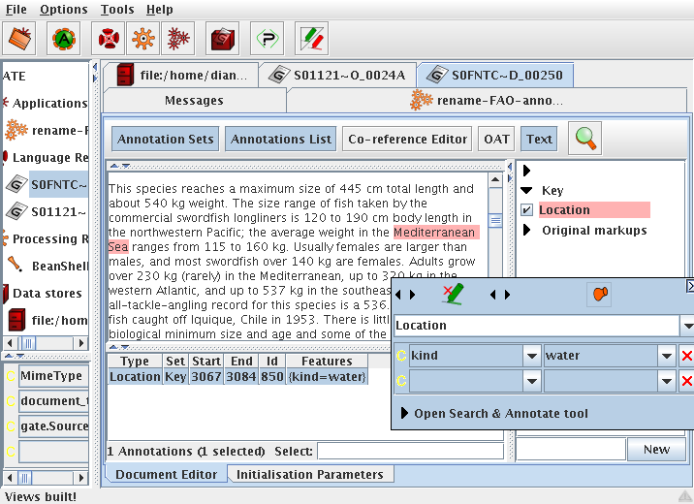
A popular CPSL implementation
GATE = General Architecture for Text Engineering

Slide 501
Rule-Based Sentiment Classification
matches_gazetteer_of_positive_words
--> label = positive
matches_gazetteer_of_negative_words
--> label = negative
IF count(positive labels) > count(negative labels)
THEN this document has positive sentiment

Slide 502
Rule-Based Sentiment Classification
matches_gazetteer_of_positive_words
--> label = positive
matches_gazetteer_of_negative_words
--> label = negative
But if your rules are going to be this simple, why do you even need GATE?

Slide 503
Advantages of Rule-Based Approaches
It often takes less time to build rules than to collect data for training a good Machine Learning system
Rules sometimes work better than machine learning on short texts because short texts don’t allow the accurate estimation of P(*)
You get instant results with rules
Writing rules is more fun for engineers than annotating data

Slide 504
What to Watch Out for When Using Rule-Based Approaches
Since a lot of time is spent building rules, you often end up collecting very little data for testing the rule-based system. This can result in over-fitted rules – rules that only work for the data in your test set.
There is a tendency to let the rules pick the examples to test on
Development bias – you use the test corpus to guide rule-writing, and as a result you end up tuning the rules to the test corpus

Slide 505
How to avoid development bias
Break your test set up into a development set and a test set
Lock up your test set till you have developed all the rules
Use the development set to develop your rules
Then, measure the performance on the test set.
Don’t use the test set more than 3 times. After three measurements, make it a part of the development set and collect a new test set.

Slide 506
Exercise 1
Build a rule-based sentiment classifier based on the AFINN gazetteer.
Measure its performance on the polarity dataset.
The datasets were downloaded from http://www.cs.cornell.edu/people/pabo/movie-review-data/
The MPQA corpus seems to be more GATE-oriented: http://mpqa.cs.pitt.edu/

Slide 507
Exercise 2
Build a rule-based sentiment classifier based on the AFINN gazetteer.
Measure its performance on the subjectivity dataset.

Slide 508
Exercise 3
Build a naïve bayesian sentiment classifier trained on 80% of the polarity dataset.
Measure its performance on the remaining 20% of the polarity dataset.

Slide 509
Exercise 4
Build a naïve bayesian sentiment classifier trained on 80% of the subjectivity dataset.
Measure its performance on the remaining 20% of the subjectivity dataset.

Slide 510
Rule-based vs Statistical Approaches
As children, we are taught this spelling rule:
“I before E except after C”
-- an example of a linguistic insight
Courtesy of http://norvig.com/chomsky.html

Slide 511
Rule-based / Statistical Approaches
Learning to choose between rule-based and statistical approaches
Courtesy of http://norvig.com/chomsky.html

Slide 512
Problem 7: Deciding Between Spelling Alternatives
Field
Wield
Shield
Deceive
Receive
Ceiling
Courtesy of http://norvig.com/chomsky.html

Slide 513
A question
Why use data-oriented methods when we can ask an expert to come up with some rules?

Slide 514
Rule-based Approach
As children, we are taught this spelling rule:
“I before E except after C”
-- an example of a linguistic insight
Courtesy of http://norvig.com/chomsky.html

Slide 515
Probabilistic Statistical Model:
Count the occurrences of ‘ie’ and ‘ei’ and ‘cie’ and ‘cei’ in a large corpus
P(IE) = 0.0177
P(EI) = 0.0046
P(CIE) = 0.0014
P(CEI) = 0.0005
The Saying:
“I before E except after C”
Courtesy of http://norvig.com/chomsky.html

Slide 516
Probabilistic Statistical Model:
Count the occurrences of ‘ie’ and ‘ei’ and ‘cie’ and ‘cei’ in a large corpus
P(IE) = 0.0177
P(EI) = 0.0046
P(CIE) = 0.0014
P(CEI) = 0.0005
The Saying:
“I before E except after C”
I normally occurs before E!!
So the first part of the saying is true!
Courtesy of http://norvig.com/chomsky.html

Slide 517
Probabilistic Statistical Model:
Count the occurrences of ‘ie’ and ‘ei’ and ‘cie’ and ‘cei’ in a large corpus
P(IE) = 0.0177
P(EI) = 0.0046
P(CIE) = 0.0014
P(CEI) = 0.0005
The Saying:
“I before E except after C”
After C, I still comes before E 75% of the time!! So the second part is incorrect!
Courtesy of http://norvig.com/chomsky.html

Slide 518
Words where ie occur after c
science
society
ancient
species
Courtesy of http://norvig.com/chomsky.html

Slide 519
Statistical Approach
Language is more complicated than humans realize …
People underestimate the complexity of the rules governing even simple things related to language …
So, we use probabilities and statistics to aid in decision making about text … instead of rules like “I before E except after C”

Slide 520
A question
If data-oriented methods can be so much better, why do people still use rule-based methods?

Slide 521
Can you use otherwise labelled data?
It turns out … finding labelled data is hard

Slide 522
Distance Learning for Sentiment Classification
Twitter Sentiment Classification using Distant Supervision by: Alec Go, Richa Bhayani, Lei Huang
Dmitry Davidiv, Oren Tsur and Ari Rappoport. 2010. Enhanced Sentiment Learning Using Twitter Hashtags and Smileys. Coling 2010.

Slide 523
Distance Learning for Sentiment Classification
Twitter Sentiment Classification using Distant Supervision by: Alec Go, Richa Bhayani, Lei Huang
Say there is a tweet:
“Havng yummy foodz @ café XYZ ☺”
Use the smileys ☺ as sentiment labels

Slide 524
Can you use unlabelled data?
But finding even that sort of data is hard

Slide 525
Now, we’ll learn about learning on unlabelled data. It’s like learning without a teacher & figuring stuff out!
Machine Learning on Unlabelled Data

Slide 526
Unsupervised Sentiment Classification
P. Turney, “Thumbs up or thumbs down? Semantic orientation applied to unsupervised classification of reviews,” in Proceedings of the Association for Computational Linguistics (ACL), pp. 417–424, 2002.

Slide 527
Can unlabelled data help?
Problem 8: Can you train a classifier on unlabelled data

Slide 528
Text Classification from Labeled and Unlabeled Documents using EM by KAMAL NIGAM, ANDREW KACHITES, SEBASTIAN THRUN, TOM MITCHELL
Training a classifier on partly labelled data

Slide 529
Training a Classifier
How do you train a classifier on very little labelled data?
Can you train a classifier on partly labelled data?
Can you change the precision and recall?

Slide 530
Problem 8: Training a classifier using EM
Train classifier 1 with a few labelled documents labelled with each of N categories.
Classify a large number of unlabelled documents using classifier 1.
Train classifier 2 using the all the documents classified by the previous classifier (1) and the original manually labelled documents.
Classify the large number of originally unlabelled documents using classifier 2.
Repeat K times …
Classifier K will be better than classifier 1.

Slide 531
Training on Partly Labelled Data
We have our third design pattern:
Training on Partly Labelled Data
When do you use it?
When there is a lot of unlabelled data available and very little labelled data.

Slide 532
Time for Exercises!
Let’s practise training a classifier with partly labelled data!

Slide 533
Can partly labelled data help?
Problem 9: Can you train a classifier to reject a category?

Slide 534
Problem 9: Training a classifier to Reject a Category
Train classifier 1 with a few documents labelled with the category to be rejected R + the category Other comprising all other labelled documents.
Classify a large number of unlabelled documents using classifier 1.
Train classifier 2 using the all the documents classified by the previous classifier (1) as R and the remaining labelled documents marked as other.
Classify the large number of originally unlabelled documents using classifier 2.
Repeat K times …
Classifier K will be better than classifier 1.

Slide 535
Training to Reject a Category
We have our fourth design pattern:
Training to Reject
When do you use it?
When you need to change the precision and recall of a classifier.

Slide 536
Problem 10: Clustering

Slide 537
What is Clustering?
Grouping data without labels in such a way that objects in the same group (called a cluster) are more similar (in some sense or another) to each other than to those in other groups (clusters)

Slide 538
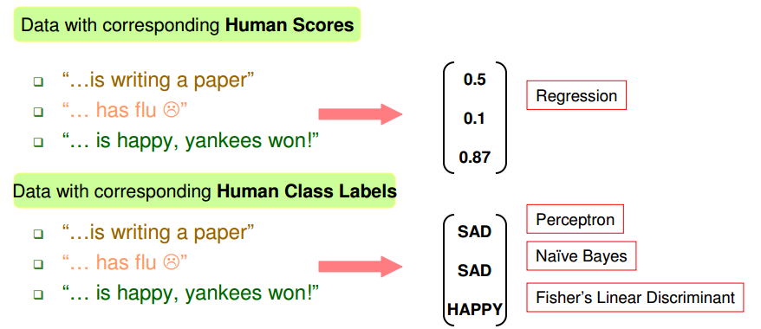
Data With Labels
Courtesy Sameer Maskey

Slide 539
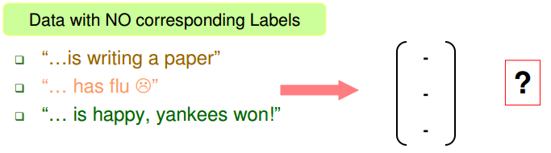
Data Without Labels
Courtesy Sameer Maskey

Slide 540
Document Clustering
Previously we classified Documents into:
Politics(Class1) and Sports (Class2)
We had labelled data
Supervised learning (classification)
If we have no labelled data
Unsupervised learning (clustering)
Courtesy Sameer Maskey

Slide 541
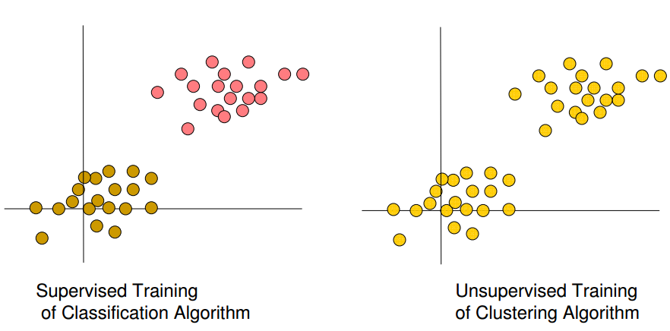
Document Clustering
Courtesy Sameer Maskey

Slide 542
Method 1: Agglomerative Hierarchical Clustering
Start with each document in its own cluster
Document 1
Document 2
Document 4
Document 3
Document 5

Slide 543
Method 1: Agglomerative Hierarchical Clustering
Calculate the distance between all pairs of clusters and merge the nearest ones
Document 1
Document 4
Document 2
Document 3
Document 5

Slide 544
Method 1: Agglomerative Hierarchical Clustering
Calculate the distance between the new cluster and all other clusters and merge the nearest pair
Document 1
Document 4
Document 2
Document 3
Document 5

Slide 545
Method 1: Agglomerative Hierarchical Clustering
Again
Document 1
Document 4
Document 2
Document 3
Document 5

Slide 546
Method 1: Agglomerative Hierarchical Clustering
And again
Document 1
Document 4
Document 2
Document 3
Document 5

Slide 547
Method 1: Agglomerative Hierarchical Clustering
And you get a hierarchy of clusters
Document 1
Document 4
Document 2
Document 3
Document 5

Slide 548
Measure the distance between 2 documents?
Model the document as:
Vector Space
Probabilistic Distribution
Then apply a distance measure or divergence:
Cosine Distance (vector space)
Manhattan Distance (vector space)
KL Divergence (probability distribution)

Slide 549
Document 1
{“This”, 2}, {“Is”, 1}
Vocabulary: 2 (can be represented in a 2-dimensional space)
1
Is
2
This

Slide 550
Document 2
{“That”, 2}, {“Is”, 1}
Vocabulary: 2 (can be represented in a 2-dimensional space)
1
Is
2
That

Slide 551
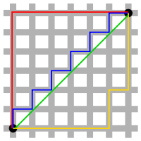
Manhattan Distance
{“This”,2},{“Is”,1},{“That”,0}
{“This”,0},{“Is”,1},{“That”,2}
Vocabulary: 3 (can be represented in a 3-dimensional space)
2 + 0 + 2

Slide 552
Euclidean Distance
{“This”,2},{“Is”,1},{“That”,0}
{“This”,0},{“Is”,1},{“That”,2}
Vocabulary: 3 (can be represented in a 3-dimensional space)
Sqrt(2*2 + 0 + 2*2)

Slide 553
Cosine Distance
{“This”,2},{“Is”,1},{“That”,0}
{“This”,0},{“Is”,1},{“That”,2}
Vocabulary: 3 (can be represented in a 3-dimensional space)
(0 + 1 + 0)/sqrt(4+ 1+0)*sqrt(0+1+4) = 1/5

Slide 554
Did you know
… that you can use a classifier …
… to do clustering?
The exercise is … think about it …

Slide 555
Method 2: K-Means
Initialize prototypes, then iterate between:
– E-step: assign each data point to nearest prototype
– M-step: update prototypes to be the cluster means
The simplest version is based on Euclidean distance
Courtesy Christopher M. Bishop’s slides

Slide 556
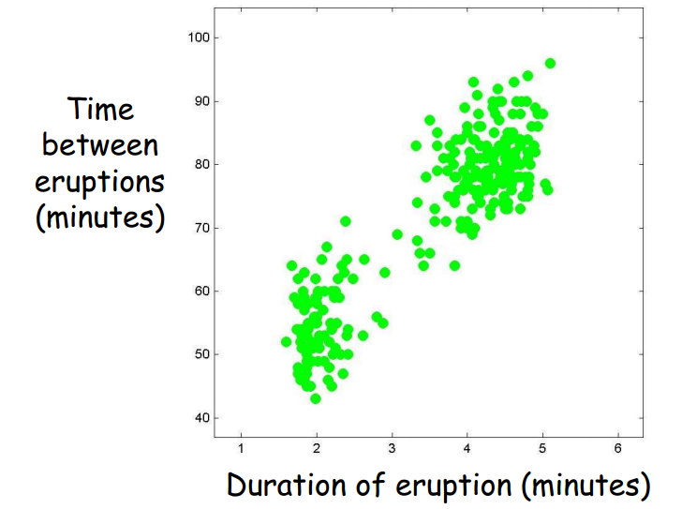
Method 2: K-Means
Courtesy Christopher M. Bishop’s slides

Slide 557
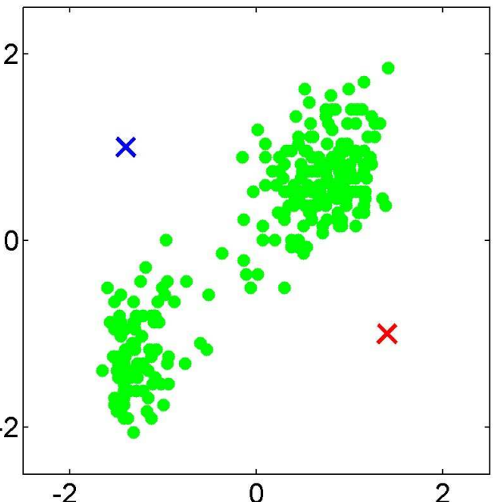
Method 2: K-Means
Courtesy Christopher M. Bishop’s slides

Slide 558
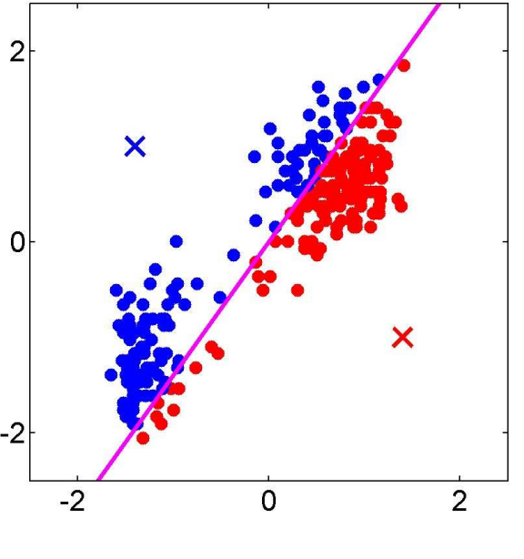
Method 2: K-Means
Courtesy Christopher M. Bishop’s slides

Slide 559
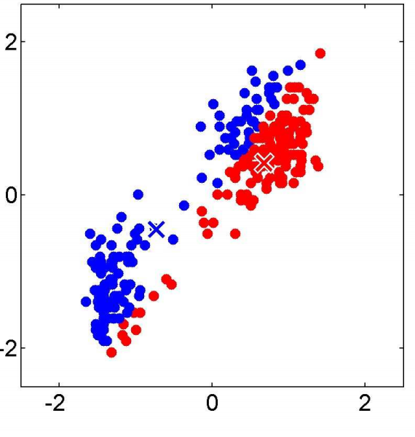
Method 2: K-Means
Courtesy Christopher M. Bishop’s slides

Slide 560
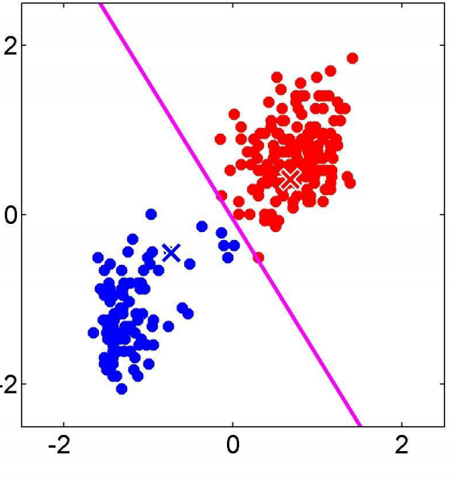
Method 2: K-Means
Courtesy Christopher M. Bishop’s slides

Slide 561
Example: K-Means
A 2-dimensional space
2
1
1
2
3
4
5

Slide 562
Example: K-Means
A 2-dimensional space – you want 2 clusters –
Pick 2 centroids at random
2
1
1
2
3
4
5

Slide 563
Example: K-Means
E-Step: Assign each of the points to the nearest centroid
2
1
1
2
3
4
5

Slide 564
Example: K-Means
M-Step: Recompute the centroid as the center of all its points
2
1
1
2
3
4
5

Slide 565
Example: K-Means
E-Step: Assign each of the points to the nearest centroid
2
1
1
2
3
4
5

Slide 566
Example: K-Means
M-Step: Recompute the centroid as the center of all its points
2
1
1
2
3
4
5

Slide 567
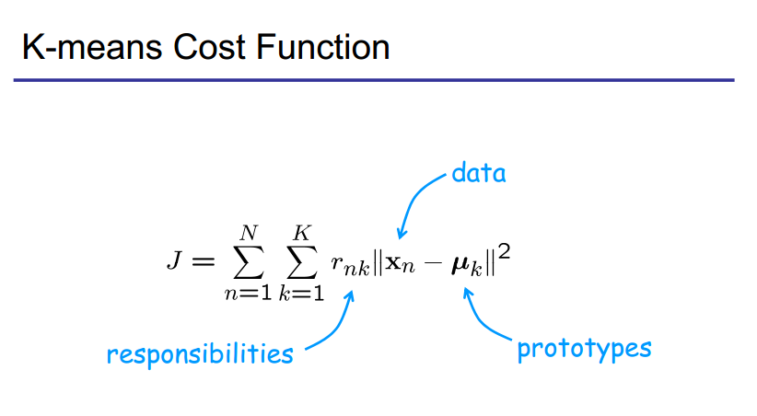
Expectation Maximization
Courtesy of Christopher Bishop

Slide 568
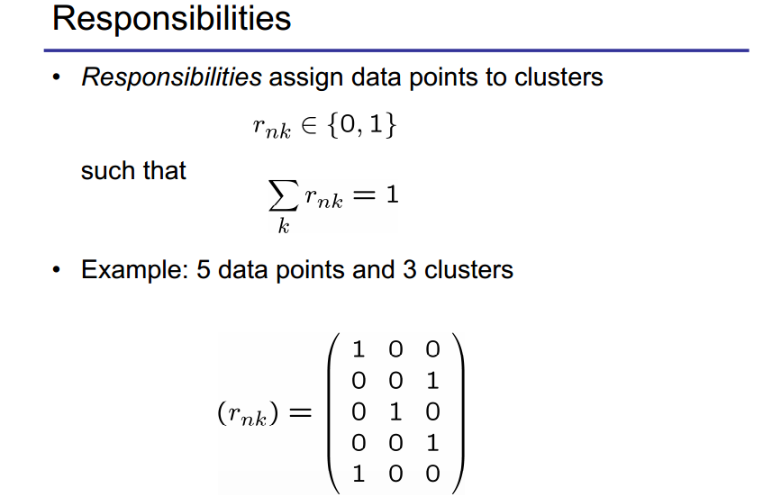
Expectation Maximization
Courtesy of Christopher Bishop

Slide 569
Example: K-Means
E-Step: Assign each of the points to the nearest centroid
2
1
1
2
3
4
5

Slide 570
Example: K-Means
M-Step: Recompute the centroid as the center of all its points
2
1
1
2
3
4
5

Slide 571
Problem 10: Clustering
Clustering documents into N clusters
Train classifier 1 with documents randomly assigned to one of N categories.
Classify documents using classifier 1.
Train classifier 2 using the documents classified by the previous classifier (1).
Classify documents using classifier 2.
Repeat K times …
The output of classifier K will be in N clusters.

Slide 572
Time for Exercises!
Let’s construct a clustering tool using a classifier!

Slide 573
Can we do extraction with unlabelled data?
Extraction with Unlabelled Data

Slide 574
Key-phrase Extraction
Bangalore, India

Slide 575
Discovering Key-phrases for Entity Extraction
Corpus
Key-phrase Extraction
Key-phrases

Slide 576
Discovering Keyphrases
Corpus:
1: Is the Canon 5 a good camera?
2: Is the Canon factory close to Mumbai?
3: Is the Canon camera made in Mumbai?
Find the words that stand out.
Canon, Mumbai
Why not: is, the, ?

Slide 577
Supervised Algorithm for extracting key-phrases
1: Generate ngrams
2: Classify some as keyphrases

Slide 578
Unsupervised Algorithm for extracting key-phrases
1: Generate ngrams
2: The ones that stand out statistically from a background corpus are the keyphrases

Slide 579
Discovering Keyphrases
Corpus:
1: Is the Canon 5 a good camera?
2: Is the Canon factory close to Mumbai?
3: Is the Canon camera made in Mumbai?
Find the words that stand out.
Canon, Mumbai
Canon and Mumbai are uncommon words that occur more often than they typically do in here.

Slide 580
Discovering Keyphrases
Corpus:
1: Is the Canon 5 a good camera?
2: Is the Canon factory close to Mumbai?
3: Is the Canon camera made in Mumbai?
Find the words that stand out.
Is, the, ?
Is, the and ? are common tokens in any corpus.

Slide 581
Algorithm for extracting key-phrases
1: Generate ngrams
Easy to do from a corpus
2: Throw out all patterns that are outstanding
Use a statistical measure

Slide 582
Statistical Measures for Identifying Key-Phrases
1: Probability Ratios
List the words with the highest probability ratios
Probability Ratio: probability in this corpus vs probability in a background corpus

Slide 583
Probability Ratios
Issues with Probability Ratios:
1: Does not work well for rare words (they get probability ratios of 1/1 or 0/0)

Slide 584
Statistical Measures for Identifying Key-Phrases
1: Probability Ratios
List the words with the highest probability ratios
Probability Ratio: probability in this corpus vs probability in a background corpus

Slide 585
Statistical Measures for Identifying Key-Phrases
2: Pointwise Mutual Information
Useful for multiple words
PMI: probability of two words occurring one after the other divided by the product of their individual probabilities

Slide 586

Statistical Measures for Identifying Key-Phrases
2: Pointwise Mutual Information
Useful for multiple words
PMI:

Slide 587
Statistical Measures for Identifying Key-Phrases
2: Kullback Leibler Divergence
Useful for individual or multiple words
KL Divergence: Kullback–Leibler divergence of Q from P, denoted D_{KL}(P‖Q), is a measure of the information lost when Q is used to approximate P

Slide 588

Statistical Measures for Identifying Key-Phrases
2: Kullback Leibler Divergence
Useful for individual or multiple words
KL Divergence:

Slide 589
Real world text analytics problem
Let’s see how you might use text analytics to solve a marketing problem!
B2B Marketing!!!
Promoting a B2B Brand

Slide 590
One Text Analytics Project

Slide 591
Applications
of
Text Analytics
to
B2B Sales and Marketing

Slide 592
The Problem: Marketing B2B Brands
How We Promote B2B Products Today
What Can Happen When You Apply Text Analytics

Slide 593


B2C and B2B Products
B2C
B2B
Advertisement
Advertisement
Image from Wikipedia
Image from Wikipedia

Slide 594
The difference between B2C and B2B marketing
is one of
targeting
Image from Wikipedia
Image from Wikipedia

Slide 595
If the product is a B2C product
B2C – A large segment of the world is a
Prospective Buyer
Customer
Customer
Customer
Accountant
Image from Wikipedia
Image from Wikipedia

Slide 596
If the product is a B2B product
B2B – People in Specific Roles in Firms are
Prospective Buyers
Not a customer
Not a customer
Customer
Accountant
Image from Wikipedia
Image from Wikipedia

Slide 597
B2B Product Buyer
The buyer is a role in a firm
There is a limited number of buyers
More targeting needed to reach buyers efficiently

Slide 598


How We Promote B2B Products Today
Digital Marketing
Search Engine Marketing
Social Media Marketing

Slide 599
Content Marketing
Marketing over the web, social media, and email by
sharing content that helps customers or prospects:
Content creation around keywords
Content dissemination on digital media
Lead capture using forms, polls and gated downloads
This is a bit of a superset of SEO (SEO is about making your
website rank high on search engines).
Image from Wikipedia

Slide 600
Example of Content Marketing
Let’s say I am Tally, and I want to promote tools for financial
accounting to Chartered Accountants.
Content creation around keywords that potential customers
might search for:
accounting, accounting software, accounting tools,
tax preparation, taxation, cost accounting, tax compliance
Content dissemination on digital media:
Web pages with articles including those keywords
http://tallysolutions.com/5- accounting -tips-for-small-firms.html
Title: 5 Amazing Accounting Tips for Small Firms
Content: Has your accounting given you spent sleepless nights
Image from Wikipedia

Slide 601

Where Your Content Marketing Doesn’t Work Great
Your content
Your competitor’s content
You
Your competitor
Image from Wikipedia
Image from Wikipedia

Slide 602
Where Your Content Marketing Doesn’t Work Great
Your followers
Your competitor’s followers
You
Your competitor
Image from Wikipedia
Image from Wikipedia

Slide 603
The above methods rely on “being found”

Slide 604

Traditional Digital Marketing Works
Just Like A Tool For Naval Warfare
Naval Mine

Slide 605

How Naval Mines Sink A Ship
Prospect
Content

Slide 606
Can Text Analytics Do Things Differently?

Slide 607

Another Way to Sink a Ship
“going out and finding the customer”

Slide 608
How Gun Fire Sinks A Ship
Prospect
You

Slide 609
Another Way to do B2B
Marketing (Sink a Ship)
Using Text Analytics
Use Text Analytics To:
Identify a Prospect (Spot a Target)
Find Contact Information (Location)
Find Out Needs and Interests (Find Heading)
Interact With Prospect (Fire a Shell)
Our research work over the past 5 years has focused on doing these 4 steps using AI (automatically).

Slide 610
1. Identify a Prospect
Get the identity of prospective buyers from:
Company websites
Social media profiles
News articles

Slide 611

Identifying Prospects – An Example

Slide 612


Web Information Extraction for List Building
Modern AI tools can search the world wide web much like a human would.

Slide 613

Results:
B2B Prospect List Culled from Twitter

Slide 614
Text Analytics Steps
Two Steps:
Named Entity Extraction/Classification
Relationship Extraction

Slide 615
Text Analytics Steps
Step 1: Named Entity Extraction / Classification:
… said Janakiram, the CEO of Minewhat, while …
Attendees included Janakiram, CEO, Minewhat …
Output:
Person: Janakiram
Company: Minewhat

Slide 616
Text Analytics Steps
Step 2: Relationship Extraction:
… said Janakiram, the CEO of Minewhat, while …
Attendees included Janakiram, CEO, Minewhat …
Output:
CEO_Of {Janakiram, Minewhat}

Slide 617
2. Obtain Contact Details
Get the contact details for prospective buyers from:
Company websites
Crunchbase
Email servers
d) Social media

Slide 618

Obtaining Contact Details

Slide 619
Text Analytics Task
Record Linkage:
cohan@aiaioo.com ⬄ Cohan Sujay Carlos
@cohansujay ⬄ Cohan Sujay Carlos
facebook.com/cohan.sujay ⬄ Cohan Sujay Carlos

Slide 620
3. Determine Heading
With a prospect, you want to know shifts in interest:
Strong Purchase Interest
Competitor
Your product
Lack of Purchase Interest

Slide 621

Text Analytics Steps
Intention Analysis – Purchase Intention

Slide 622

Intention Analysis – Sell Intention

Slide 623
Intention Analysis – Categories of Intention
Categories | Parent Category |  | Department |  | Urgency |  |  |  | Source
Purchase |  |  | Sales |  | High |  |  |  | CRM
Sell |  |  | Procurement |  | Medium |  |  |  | ERP
Inquire |  |  | Help/Sales |  | High |  |  |  | CRM
Direct |  |  | Operations |  | High |  |  |  | CRM
Compare |  |  | Market Research |  | Low |  |  |  | CRM
Suggest |  |  | Market Research |  | Low |  |  |  | Social
Opine |  |  | Design |  | Low |  |  |  | Social
Praise | Opine |  | Design |  | Low |  |  |  | Social
Criticize | Opine |  | Design |  | Low |  |  |  | Social
Complain |  |  | Customer Service |  | High |  |  |  | CRM/Social
Accuse |  |  | Customer Service |  | Critical |  |  |  | CRM
Quit |  |  | Customer Service |  | Critical |  |  |  | CRM/Social
Express |  |  | Call Center Training |  | Low |  |  |  | Transcripts
Thank | Express |  | Call Center Training |  | Low |  |  |  | Transcripts
Apologize | Express |  | Call Center Training |  | Medium |  |  |  | Transcripts
Empathize | Express |  | Call Center Training |  | Medium |  |  |  | Transcripts

Slide 624
The following give you clues to the level of interest
I just read this article about B2B marketing!
How do people go about doing B2B marketing?
I am looking for good tools for B2B marketing.
Is tool XYZ for B2B marketing better than tool ABC?

Slide 625




Examples of Leads at the Moment of Purchase
Found using Intention Analysis

Slide 626
4. Engage
Find ways to establish some kind of interaction typically using:
Safe likes
Safe follows
Responding to inquiries or concerns

Slide 627
Text Analytics Tasks
Safety checks:
Ensure that any message that you like is not offensive or inappropriate.
If you’re sharing a message, ensure that the message being shared is not about or by your competitor.
Ensure that you don’t follow somebody who is politico-religious hazardous material.

Slide 628
What I’ve covered in this use-case
Solving a business problem end to end
Reducing business processes to text analytics steps

Slide 629
Are we done?
… kinda …
The more training you have, the better you will get at text analysis … so keep learning!

Slide 630
How to Learn More?
Grab the UC Berkeley Natural Language Processing Course’s slides. The course’s name is CS 294.
Start reading the ACL conference’s research papers (ACL = Association of Computational Linguistics)

Slide 631
THE END
Text Analytics Course – 2 Day
Cohan Sujay Carlos
Aiaioo Labs
Bangalore
The bottom

